Slide 1
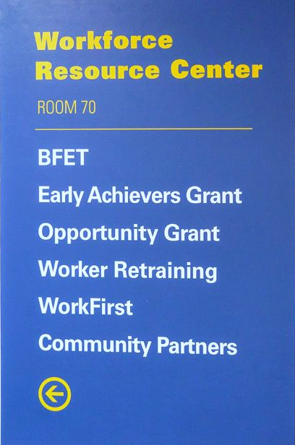
Tacoma Community College
Workforce Grants & Application Workshop
Workforce Education Department
Building 19- Room 70
Phone:253.566.5188
Email: tccworkforce@tacomacc.edu
www.tacomacc.edu/workforce
Virtual Lobby- Tuesday & Thursday 1pm-3pm
Link to Zoom: https://tacomacc-edu.zoom.us/j/94203576830
Notes:
Introduction, agenda

Slide 2
Today’s Agenda
1
Go over PowerPoint presentation to learn about Workforce programs
2
Complete and Submit the online Workforce Intake Application
3
Review the Workforce Student Checklist
4
Answer questions

Slide 3
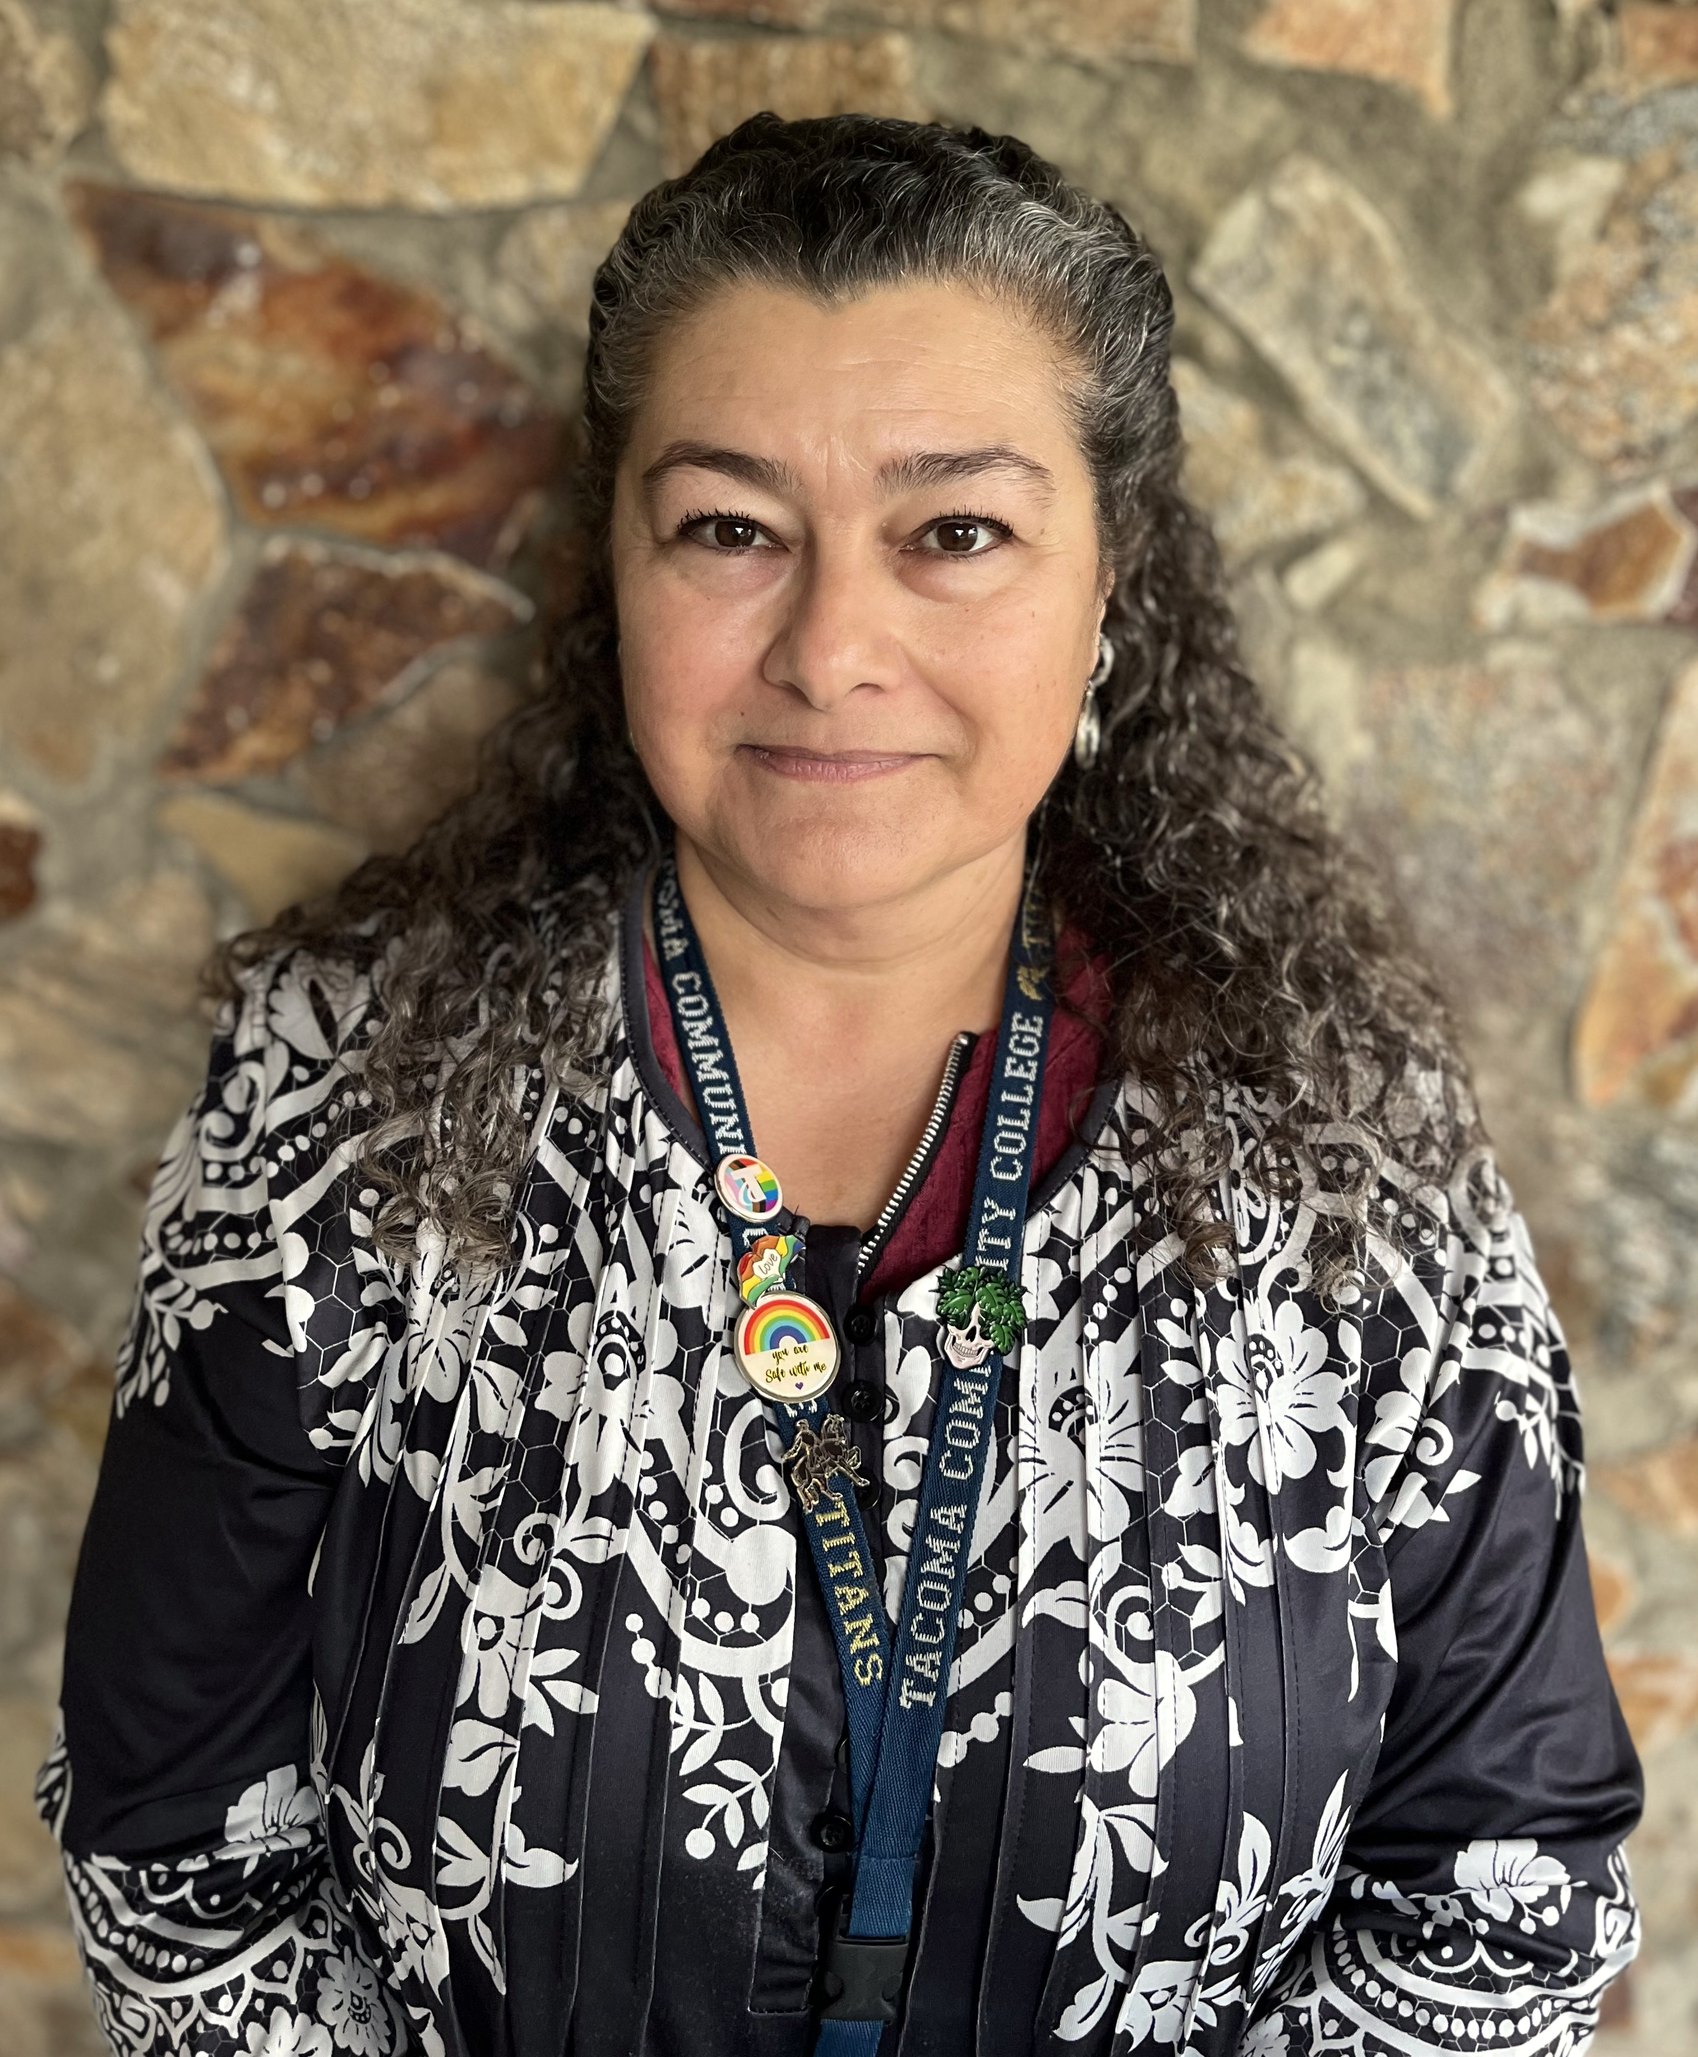



Meet Our Team
Tamara Piñero, Office Manager
Jena McNeley, Financial Aid Specialist
Tram Nguyen, Program Specialist
Shine Lee, Administrative Assistant
Notes:
Need more workstudy Pic

Slide 4


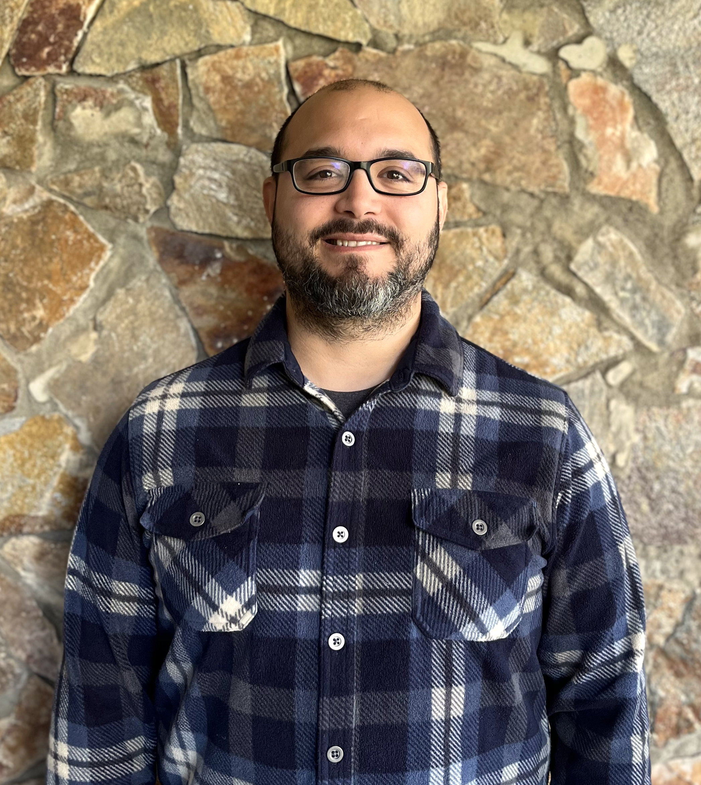




Meet Our Navigators
Adam Meyers- Business, Paralegal, Technology
Accounting, Business, Networking and Cyber Security, Paralegal, VIE 25, Medical Billing, HIT
Tuyen Huynh- Specific Academic Transfer & Transitional Studies
ABE, ELA, HS+, Fresh Start, IBEST, CCPA
Dail Rodriguez- Healthcare
(Students last name A- K )
Allied Health, Nursing, Respiratory Therapy, Radiologic Science, DMS, EMT, EMS
Chanry Yann- Healthcare
(Students last name L- Z )
Allied Health, Nursing, Respiratory Therapy, Radiologic Science, DMS, EMT, EMS
Marisa Mezs- Early Childhood Education
Lorrie Ann
Resource & Outreach Navigator
Pwint KoKo- Bachelor Programs
Notes:
Check the pathways tittles

Slide 5
What are the Workforce Education Grants?
WorkFirst
Basic Food Employment & Training (BFET)
Worker Retraining
Opportunity Grant
Early Achievers Grant

Slide 6
WorkFirst Eligibility Requirements
Must Be a Temporary Aid to Needy Families (TANF) Recipient
Must Be Referred from a Department of Social and Health Services (DSHS) Case Manager
Attendance Must Be Reported Weekly Through Canvas
Workfirst can assist with Professional- Technical Degrees, Certificates, and Academic Transfer Programs!

Slide 7
Basic Food Employment & Training
(BFET) Eligibility Requirements
Must be Receiving Supplemental Nutrition Assistance Program (SNAP)
Cannot be Receiving TANF
Monthly Check-ins with your Workforce Navigator in Canvas are Required
BFET can assist with Professional- Technical Degrees, Certificates, and specific Academic Transfer Programs!

Slide 8
Worker Retraining Eligibility Requirements
Currently Collecting Unemployment
Collected Unemployment in the Last 4 Years
Discharged from Military Service in the Last 4 Years
Closed a State-licensed Business within the Last 4 Years
Became a Displaced Homemaker in the Last 4 Years and are Low-Income
Worker in Need of Skills Upgrade

Slide 9
Opportunity Grant Eligibility Requirements
200 % of Federal Poverty Level 2025
Household Monthly Income
Household of 1
Household of 2
$2608.33
$3525.00
Household of 3
$4441.67
Household of 4
$5358.33
Household of 5
$6275.00
Household of 6
$7191.67
Must be a Washington State Resident & Enrolled in a Professional Technical Training Program
Notes:
Update the income!

Slide 10
Early Achievers Grant Eligibility Requirements
State Grant for Early Childhood Education Students Who Are:
Working in a Daycare or Pre-school that is Early Achiever Certified
Worked at the Daycare or Preschool for the Last 3 Months
Worked at the Daycare or Preschool for the Last 3 Months for at least 40 Hours per Month
Significant Documentation and Monthly Contact with Workforce Navigator is Required

Slide 11
What Do Workforce Funds Cover?
Grants are for start-up, gap filling, and dependent on budget
Fees
Tuition
Book

Slide 12

Purpose of Grants: Workforce Education Grants are not intended to cover the entire cost of a degree. They are designed to provide start-up and fill-in-gap assistance for specific needs related to education and training.
Case-by-Case Basis: Funding assistance for tuition and required textbooks is provided on a case-by-case basis, contingent upon the availability of funds and the identification of a funding gap. This emphasizes that not all students may receive this assistance.
Quarterly Determination: The allocation of funds for subsequent quarters is not guaranteed. Each quarter's funding is assessed independently, and students should not assume ongoing support beyond the current quarter.
Request for Funding: To be considered for workforce funding, students must request funding for each quarter. This ensures that students actively communicate their needs and allows for a more flexible approach to disbursement.

Slide 13

Any questions?

Slide 14
Programs of Study Supported by Workforce Education
https://www.tacomacc.edu/help/ineedskillstofindaprofessionalcareer
Business, Paralegal, Technology Pathways
Accounting, 5 certificates and AAS
Healthcare Pathways
Allied Health, AAS-T
Diagnostic Medical Sonography, AAS
Education & Human Services Pathways
Early Childhood Education, 3 stackable certificates and AAS
Paralegal, AAS and Preferred Pro-cert
Nursing, RN, AAS-T; LPN to RN; NAC
Radiologic Science, AAS
Respiratory Therapy, AAS
Emergency Medical & Health Services, AAS; EMT and Paramedic certificates
Health Information Technology, AAS; Medical Billing Specialist & Medical Scribe Certificates
Human Services, AAS ; CDC certificate and Case Aid cert
Business, 6 certificates and AAS
Network and Cyber Security, AAS; Help Desk & Technical Support certificates
BFET and WorkFirst Grants are also available to help with specific academic transfer programs such as Business DTA, Computer Science, Biology, and more. More programs can be found at https://www.tacomacc.edu/help/transfertocollege
Notes:
Add a specific transfer program for BFET/ WF

Slide 15

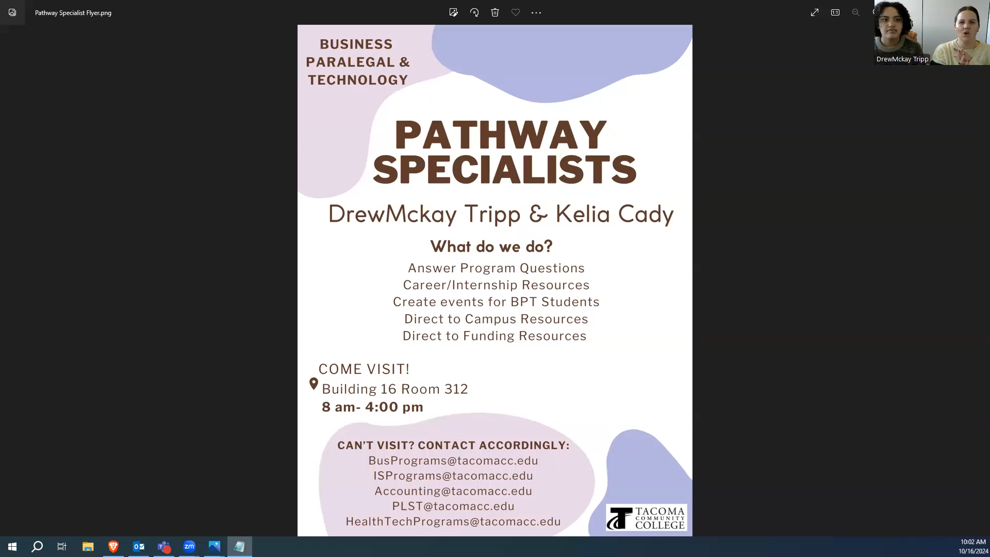
Attend a Business, Paralegal, & Technology Information Session to learn more about programs!
www.tacomacc.edu/bus-para-tech
Notes:
Need to update!

Slide 16

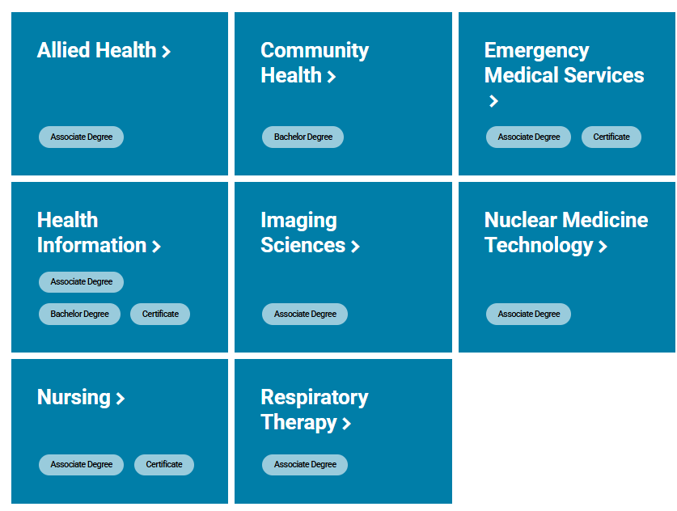
Attend a Healthcare Pathways Information Session to learn more about programs!
Contact to help you navigate your pathway to a career in Healthcare.
Email: healthprograms@tacomacc.edu
www.tacomacc.edu/healthcareers
Notes:
During the session, you can hear a high-level overview on our healthcare programs we offer at TCC and how to enroll into them. This information session happens twice a month, every month. There will be an in-person and a virtual option.

Slide 17
Workforce Education also Supports
Basic Education for Adults and ELA
https://www.tacomacc.edu/academics-programs/basic-education/
High School Completion Programs
Adult Basic Education Classes
English Language Acquisition
Career and College Pathway Academy- Offered depending on the quarters
Learning Communities: In Learning Communities, two or more of your classes are joined into one, and teachers work together to connect their content and support and mentor you.
Allied Health Exploration (8 credits/hybrid): Gain an introduction to the delivery of healthcare services and explore the various Allied Health professions while strategizing and sharing successful strategies for the college classroom, clinical environment, and taking care of your own emotional and physical wellbeing.

Slide 18
Financial Aid
FAFSA
Free Application for Federal Student Aid (FAFSA)
FAFSA Tips
Helpful Hints
Check Your Student Email and CTCLink, “To Do” Box Closely Follow-up with any Additional Needed Actions
Keep in mind
Grants : Grants do not have to be paid back, as long as you maintain satisfactory academic progress.
Scholarships: Scholarships do not have to be paid back, and are awarded for academic merit, financial need, athletic or artistic talent, community involvement and fields of study.
Federal or State Work-study: These programs provide an opportunity to earn a portion of your financial aid through part time employment, both on- and off-campus. Funds are very limited.
Loans: Loans must be repaid.
Check TCC Financial Aid Page for more information
All Workforce Students Must Complete The Free Application for Federal Student Aid Each Year
FAFSA and WASFA Completion Assistance:
Complete Application By Priority Deadline, or as Soon as Possible
Check Out Important Information About Financial Aid at TCC Website
FAFSA completion is based off of completion of FAFSA, application to TCC, and all requested documents being submitted.
Make sure you have a profile created for yourself and spouse if you are married.
Self- enrollment in Financial Aid and Planning Canvas is essential for success, you can self-enroll from the TCC Financial Aid Page
Sauna, Khushnum
(253)722-3429
ksauna@mdc-hope.org

Slide 19
Working While Attending School
Options to Consider
Request for Federal or State Work Study from the Financial Aid Office, then apply for a Workstudy Position
Employment Resources
TCC career center ( https://www.tacomacc.edu/tcc-life/career_center)
Worksource Pierce (https://worksource-pierce.org/)
Look for Part-time Work in Your Field of Study if Possible

Slide 20
Workforce Community Partners On-Campus
We are thrilled to introduce the incredible community partners who work alongside us to support our students' success! These dedicated organizations offer valuable resources and services that can make a real difference in the academic journey.
Career Team
Days: Tuesdays
Meet with Audrey for assistance with education, employment, and training resources, including job search, connections to WIOA programs, and other resources.
Click here to schedule an appointment with Audrey
Northwest Education Access
Days: Wednesdays & Thursdays
Meet with Haley to explore educational supports and connect with a NWEdA Advocate who can provide guidance and resources tailored to your needs.
Contact Workforce to make an appointment.
United Way: Financial Coach
Days: Monday-Tuesday, Thursday-Friday
Meet with Charisma to plan your financial future, focusing
on budgeting, expense management, credit building, and savings strategies.
Attend the Financial Literacy 101 workshop offered by Charisma.
Click here to schedule a one-on-one appointment with Charisma.

Slide 21

Student Services
TCC Makes a Commitment to Every Student that No Matter Where You Start or What You Hope to ​Achieve, We Will Educate and Support You, and Provide You with Opportunities to Help Meet Your Goals https://www.tacomacc.edu/help/im-a-current-student
TCC Help Center Website
Academic Advising
Laptops
Tutoring virtual and In-Person
Workforce Navigators
Access Services Support for Those Needing Accommodations
Food Pantry
Counseling
Technical Assistance
Hot Spots
Open Educational Resources (OER)

Slide 22
Putting together the puzzle pieces to meet all of your needs to achieve your goal!
Learn about campus, community and government resources, receive guidance with applying for food and health benefits, get direct referral to community programs.
Contact:
Lorrie Ann, Resource Navigator
253-566-5247
lann@tacomacc.edu
Click here to schedule an appointment with me
Visit Resources Page
www.tacomacc.edu/workforce/resources

Slide 23

Time to Begin Your Workforce Intake Application & Checklist
Complete the Workforce Student Checklist
Complete the Workforce Intake Application
The Link to the Intake Application is below & Checklist Can Be Found in the Confirmation email
To Become a Workforce Student
Click Here To Complete The Workforce Intake Application
Contact The Workforce Education Department If You Need any Assistance
☎ 253.566.5188 Email: tccworkforce@tacomacc.edu
www.tacomacc.edu/workforce
Note: Please be aware that the Workforce Education Grants are not designed to pay for entire degrees. Students who are eligible for Workforce Education Grants may get first-quarter funding assistance to cover tuition and/or required textbooks on a case-by-case basis if funds are available and a gap in funding is identified. Funding for subsequent quarters is determined on a quarter-by-quarter basis and is not guaranteed. If you would like to be considered for the Workforce funding you must request funding every quarter.

