Slide 1

Tacoma Community College
Workforce Grants & Application Workshop
Workforce Education Department
Building 19 Room 70
Mon-Friday 8am-5pm
Phone:253.566.5188
Email: tccworkforce@tacomacc.edu
www.tacomacc.edu/workforce
Virtual Lobby- Monday & Tuesday 1pm-3pm
Link to Zoom: https://tacomacc-edu.zoom.us/j/88050808422
Notes:
Introduction, agenda

Slide 2
Today’s Agenda
1
Go over PowerPoint presentation to learn about Workforce Programs
2
Complete and Submit online Workforce Intake Application
3
Review Workforce Student Checklist
4
Answer questions

Slide 3


Meet Our Team
Jena McNeley, Financial Aid Specialist
Tamara Piñero, Office Manager
Notes:
Need more workstudy Pic

Slide 4

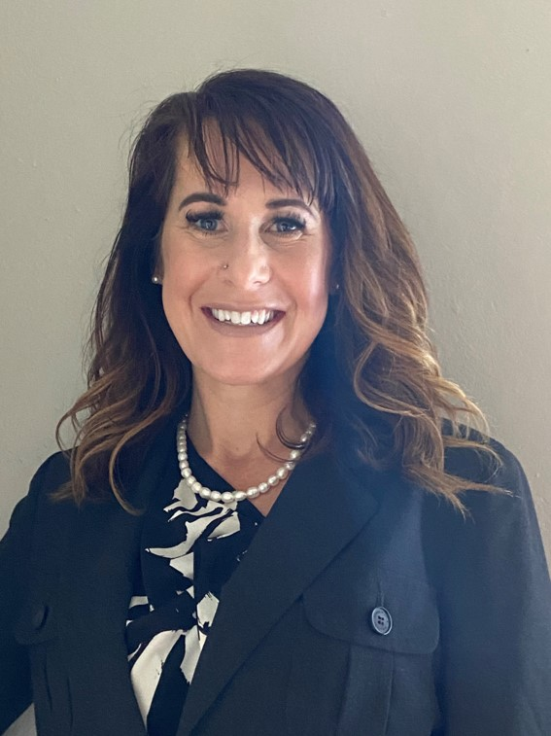
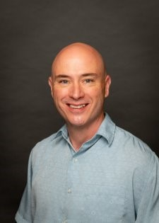
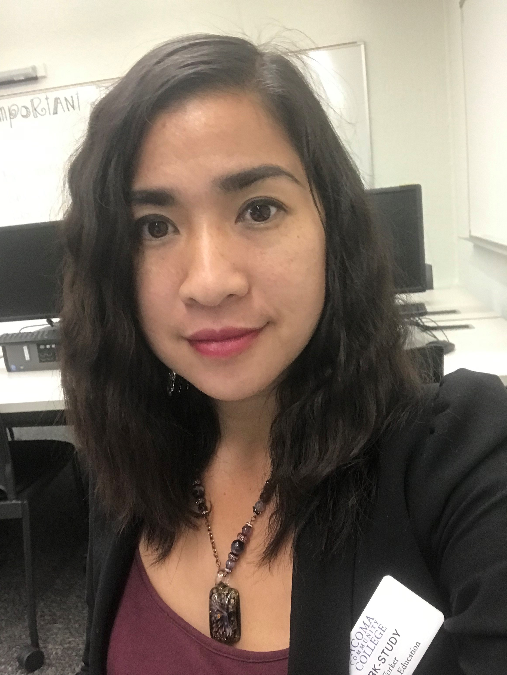


Meet Our Navigators
Adam Meyers- Business, Paralegal, Technology Pathways
Accounting, Business, Networking and Cyber Security, Paralegal, VIE 25
Angie Christoph- Education & Human Services Pathways
Early Childhood Education, Human Services, Chemical Dependency
Chanry Yann-
Healthcare Pathways
Allied Health, Nursing, Respiratory Therapy, Radiologic Science, DMS, HIT, Medical Billing, EMT, EMS
Pwint KoKo- Specific Academic Transfer Programs, Bachelor Programs
Thi Huynh- Transitional Studies
ABE, ELA, HS+, Fresh Start, IBEST, CCPA
Lorrie Ann
Resource & Outreach Navigator
Notes:
Check the pathways tittles

Slide 5
What are the Workforce Education Grants?
WorkFirst
Basic Food Employment & Training (BFET)
Worker Retraining
Opportunity Grant
Early Achiever Grant

Slide 6
WorkFirst Eligibility Requirements
Must Be a Temporary Aid to Needy Families (TANF) Recipient
Must Be Referred from a Department of Social and Human Services (DSHS) Case Manager
Attendance Must Be Reported Weekly Through Canvas

Slide 7
Basic Food Employment & Training
(BFET) Eligibility Requirements
Must be Receiving Supplemental Nutrition Assistance Program (SNAP)
Cannot be Receiving TANF
Monthly Check-ins with your Workforce Navigator in Canvas are Required
BFET can assist specific Academic Transfer Programs:
Associate of Arts in Biology, Business, Computer Science, Music, Pre-nursing
Associate of Science with specialization in Astronomy/Physics; Atmospheric Science; Biology; Chemistry; Computer Engineering; Earth Sciences; General Engineering; Environmental Sciences.
Associate of Science in Bioengineering and Chemical Engineering, Computer Engineering, Electrical Engineering, Mechanical, Civil, Aeronautical, Industrial and Material Science Engineering

Slide 8
Worker Retraining Eligibility Requirements
Currently Collecting Unemployment
Collected Unemployment in the Last 4 Years
Discharged from Military Service in the Last 4 Years
Closed a State-licensed Business within the Last 4 Years
Became a Displaced Homemaker in the Last 4 Years and are Low-Income
Worker in Need of Skills Upgrade
Worker Retraining funding maybe available for BAS degrees.

Slide 9
Opportunity Grant Eligibility Requirements
200 % of Federal Poverty Level 2023
Household Monthly Income
Household of 1
Household of 2
$2430
$3287
Household of 3
$4143
Household of 4
$5000
Household of 5
$5857
Household of 6
$6713
Must be a Washington State Resident & Enrolled in a Professional Technical Training Program, HIM BAS, or Community Health BAS

Slide 10
Early Achiever Grant Eligibility Requirements
State Grant for Early Childhood Education Students Who Are:
Working in a Daycare or Pre-school that is Early Achiever Certified
Worked at the Daycare or Preschool for the Last 3 Months
Worked at the Daycare or Preschool for the Last 3 Months for at least 40 Hours per Month
Significant Documentation and Monthly Contact with Workforce Navigator is Required

Slide 11
What Do Workforce Funds Cover?
Grants are Designed for Start-up & Fill in the Gap, Funding Determined Quarterly
Fees
Tuition
Book

Slide 12

Any questions?

Slide 13
Programs of Study Supported by Workforce Education
Professional and Technical Degrees and Certificates
https://www.tacomacc.edu/help/ineedskillstofindaprofessionalcareer
Business, Paralegal, Technology Pathways
Accounting, 5 certificates and AAS
Healthcare Pathways
Allied Health, AAS-T
Diagnostic Medical Sonography, AAS
Education & Human Services Pathways
Early Childhood Education, 3 stackable certificates and AAS
Paralegal, AAS and Preferred Pro-cert
Nursing, RN, AAS-T; LPN to RN; NAC
Radiologic Science, AAS
Respiratory Therapy, AAS
Emergency Medical & Health Services, AAS; EMT and Paramedic certificates
Health Information Technology, AAS; Medical Billing Specialist & Medical Scribe Certificates
Human Services, AAS ; CDC certificate and Case Aid cert
Business, 6 certificates and AAS
Network and Cyber Security, AAS; Help Desk & Technical Support certificates

Slide 14

Seeking a rewarding career in accounting?
Planning to start your own successful business?
Looking to acquire and enhance technical skills in IT?
Interested in a professional legal career?
Attend a Business, Paralegal & Technology Pathway Information Session to learn about programs!
Sessions are offered every 2nd and 4th Tuesday of the month at 11-11:30am starting on April 11th in Bldg. 16, Room 108.
Just show up!

Slide 15

Want to be in Healthcare, but not with direct patient care?
Want to be a part of the largest and fasted growing industry with stability and opportunity for growth?
Do you know the difference between Sonography and Radiology?
Are you interested in learning the difference between EMT and Nursing?
Do you want to make a comfortable wage while helping others?
Are you interested in job security and competitive salaries?
Looking to gain real-world experience in a healthcare program?
Want to be in Healthcare, but not sure which program to choose at TCC?
Attend a Healthcare Pathways Information Session to learn more about programs!
In-Person option, 3rd Wednesday of each month at 11:30am, building 13 room 222
Virtual option: Zoom Meeting, 1st Wednesday of each month at 3:30pm
https://tacomacc-edu.zoom.us/j/2534602368 Or you can join with the meeting ID: 253 460 2368
https://www.tacomacc.edu/academics-programs/health-careers
Notes:
During the session, you can hear a high-level overview on our healthcare programs we offer at TCC and how to enroll into them. This information session happens twice a month, every month. There will be an in-person and a virtual option.

Slide 16
Workforce Education also Supports
Basic Education for Adults and ELA https://www.tacomacc.edu/academics-programs/basic-education/
High School Completion Programs
Adult Basic Education Classes
English Language Acquisition
Career and College Pathway Academy

Slide 17
Financial Aid
FAFSA
Free Application for Federal Student Aid (FAFSA)
FAFSA Tips
Helpful Hints
Check Your Student Email and CTCLink, “To Do” Box Closely Follow-up with any Additional Needed Actions
Be Aware
Avoiding Loans Can Be the Key to Success
All Workforce Students Must Complete The Free Application for Federal Student Aid Each Year
Complete Application By Priority Deadline, or as Soon as Possible
Use the IRS Data Retrieval Tool When Completing Your FAFSA
Check Out Important Information About Financial Aid at TCC Online
Ask Your Navigator About Financial Literacy Community Resources

Slide 18
Working While Attending School
Options to Consider
Apply for Federal or State Work Study Positions
Employment Resources
Look for Part-time Work in Your Field of Study if Possible
TCC career center ( https://www.tacomacc.edu/tcc-life/career_center)
Check the Box on Your FAFSA
Worksource Pierce (https://worksource-pierce.org/)

Slide 19

Student Services
TCC Makes a Commitment to Every Student that No Matter Where You Start or What You Hope to ​Achieve, We Will Educate and Support You, and Provide You with Opportunities to Help Meet Your Goals https://www.tacomacc.edu/help/im-a-current-student
TCC Help Center Website
Academic Advising
Laptops
Tutoring virtual and In-Person
Workforce Navigators
Access Services Support for Those Needing Accommodations
Food Pantry
Counseling
Technical Assistance
Hot Spots

Slide 20
Putting together the puzzle pieces to meet all of your needs to achieve your goal!
Learn about campus, community and government resources, receive guidance with applying for food and health benefits, get direct referral to community programs.
Contact:
Lorrie Ann, Resource Navigator
253-566-5247
lann@tacomacc.edu
Click here to schedule an appointment with me
Visit Resources Page
www.tacomacc.edu/workforce/resources

Slide 21

Time to Begin Your Workforce Intake Application & Checklist
Complete the Workforce Student Checklist
Complete the Workforce Intake Application
The Link to the Intake Application is below & Checklist Can Be Found in the Confirmation email
To Become a Workforce Student
Click Here To Complete The Workforce Intake Application
Contact The Workforce Education Department If You Need any Assistance
☎ 253.566.5188 Email: tccworkforce@tacomacc.edu
www.tacomacc.edu/workforce

