Slide 1


Workforce Grants & Application Workshop
Workforce Education Department
Building 19- Room 70
Phone:253-566-5188
tccworkforce@tacomacc.edu
tacomacc.edu/workforce

Slide 2
Today’s Agenda
1
2
Complete & Submit Workforce Intake Application
3
Review Workforce Student Checklist
Overview of Workforce Programs

Slide 3
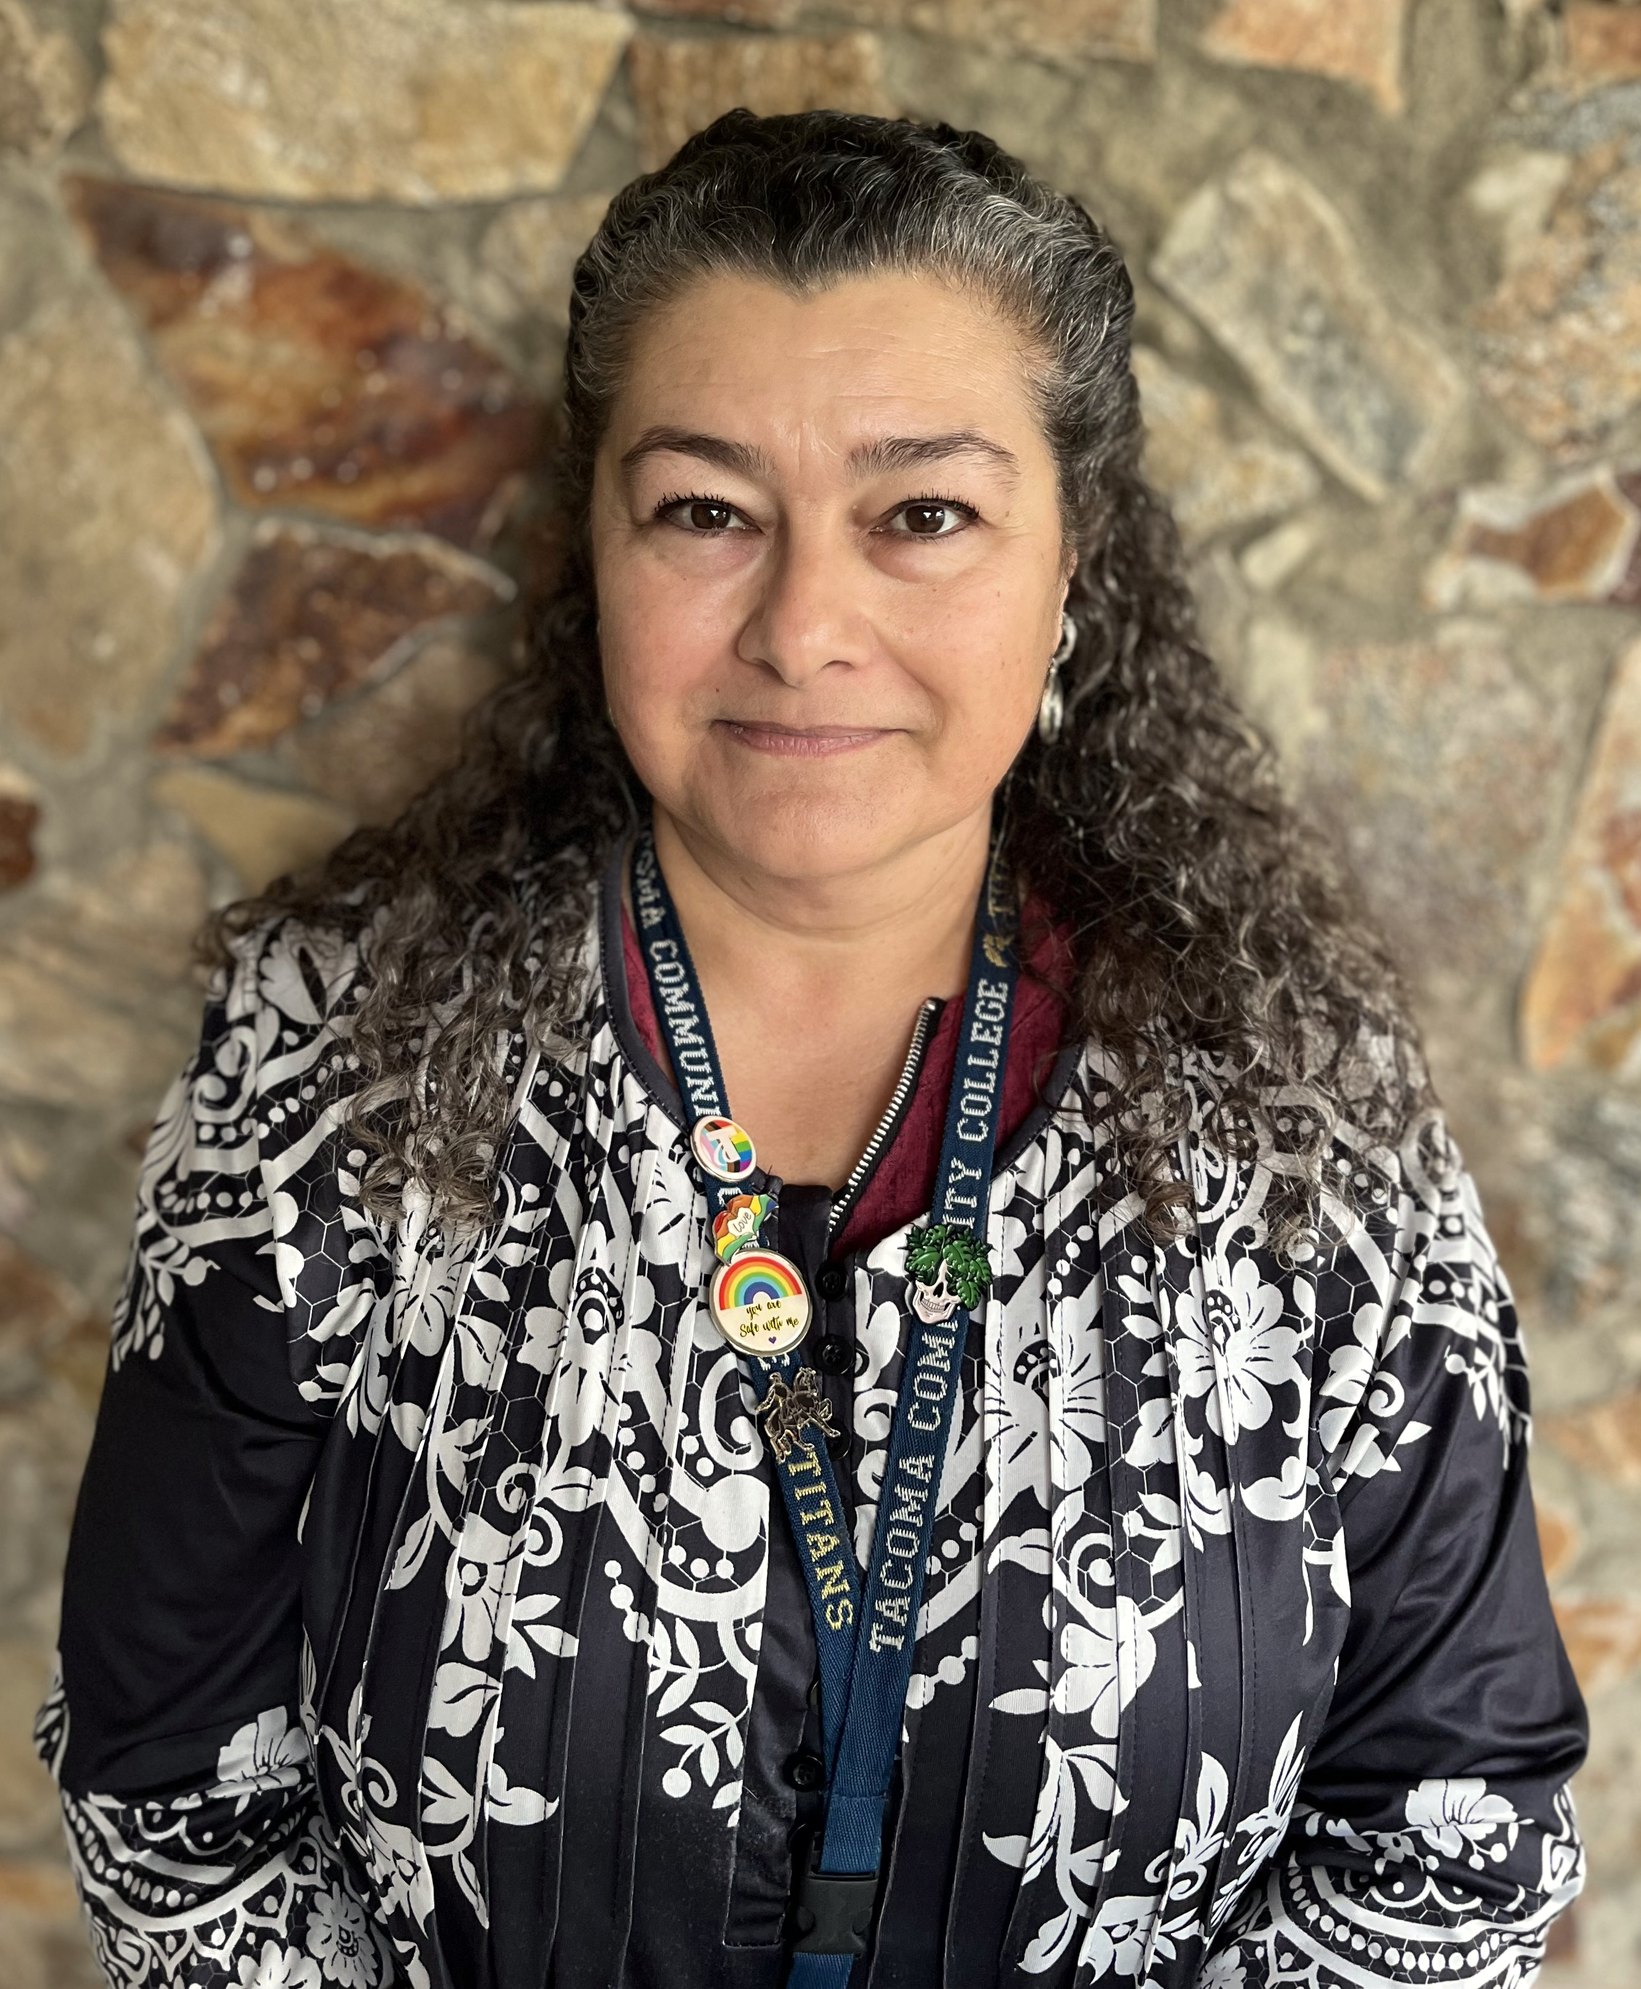



Meet Our Team
Tamara Piñero, Front Desk Manager
Jena McNeley, Financial Aid Specialist
Loretta Newcomer, Program Specialist
Shine Lee, Administrative Assistant
Notes:
Need more workstudy Pic

Slide 4

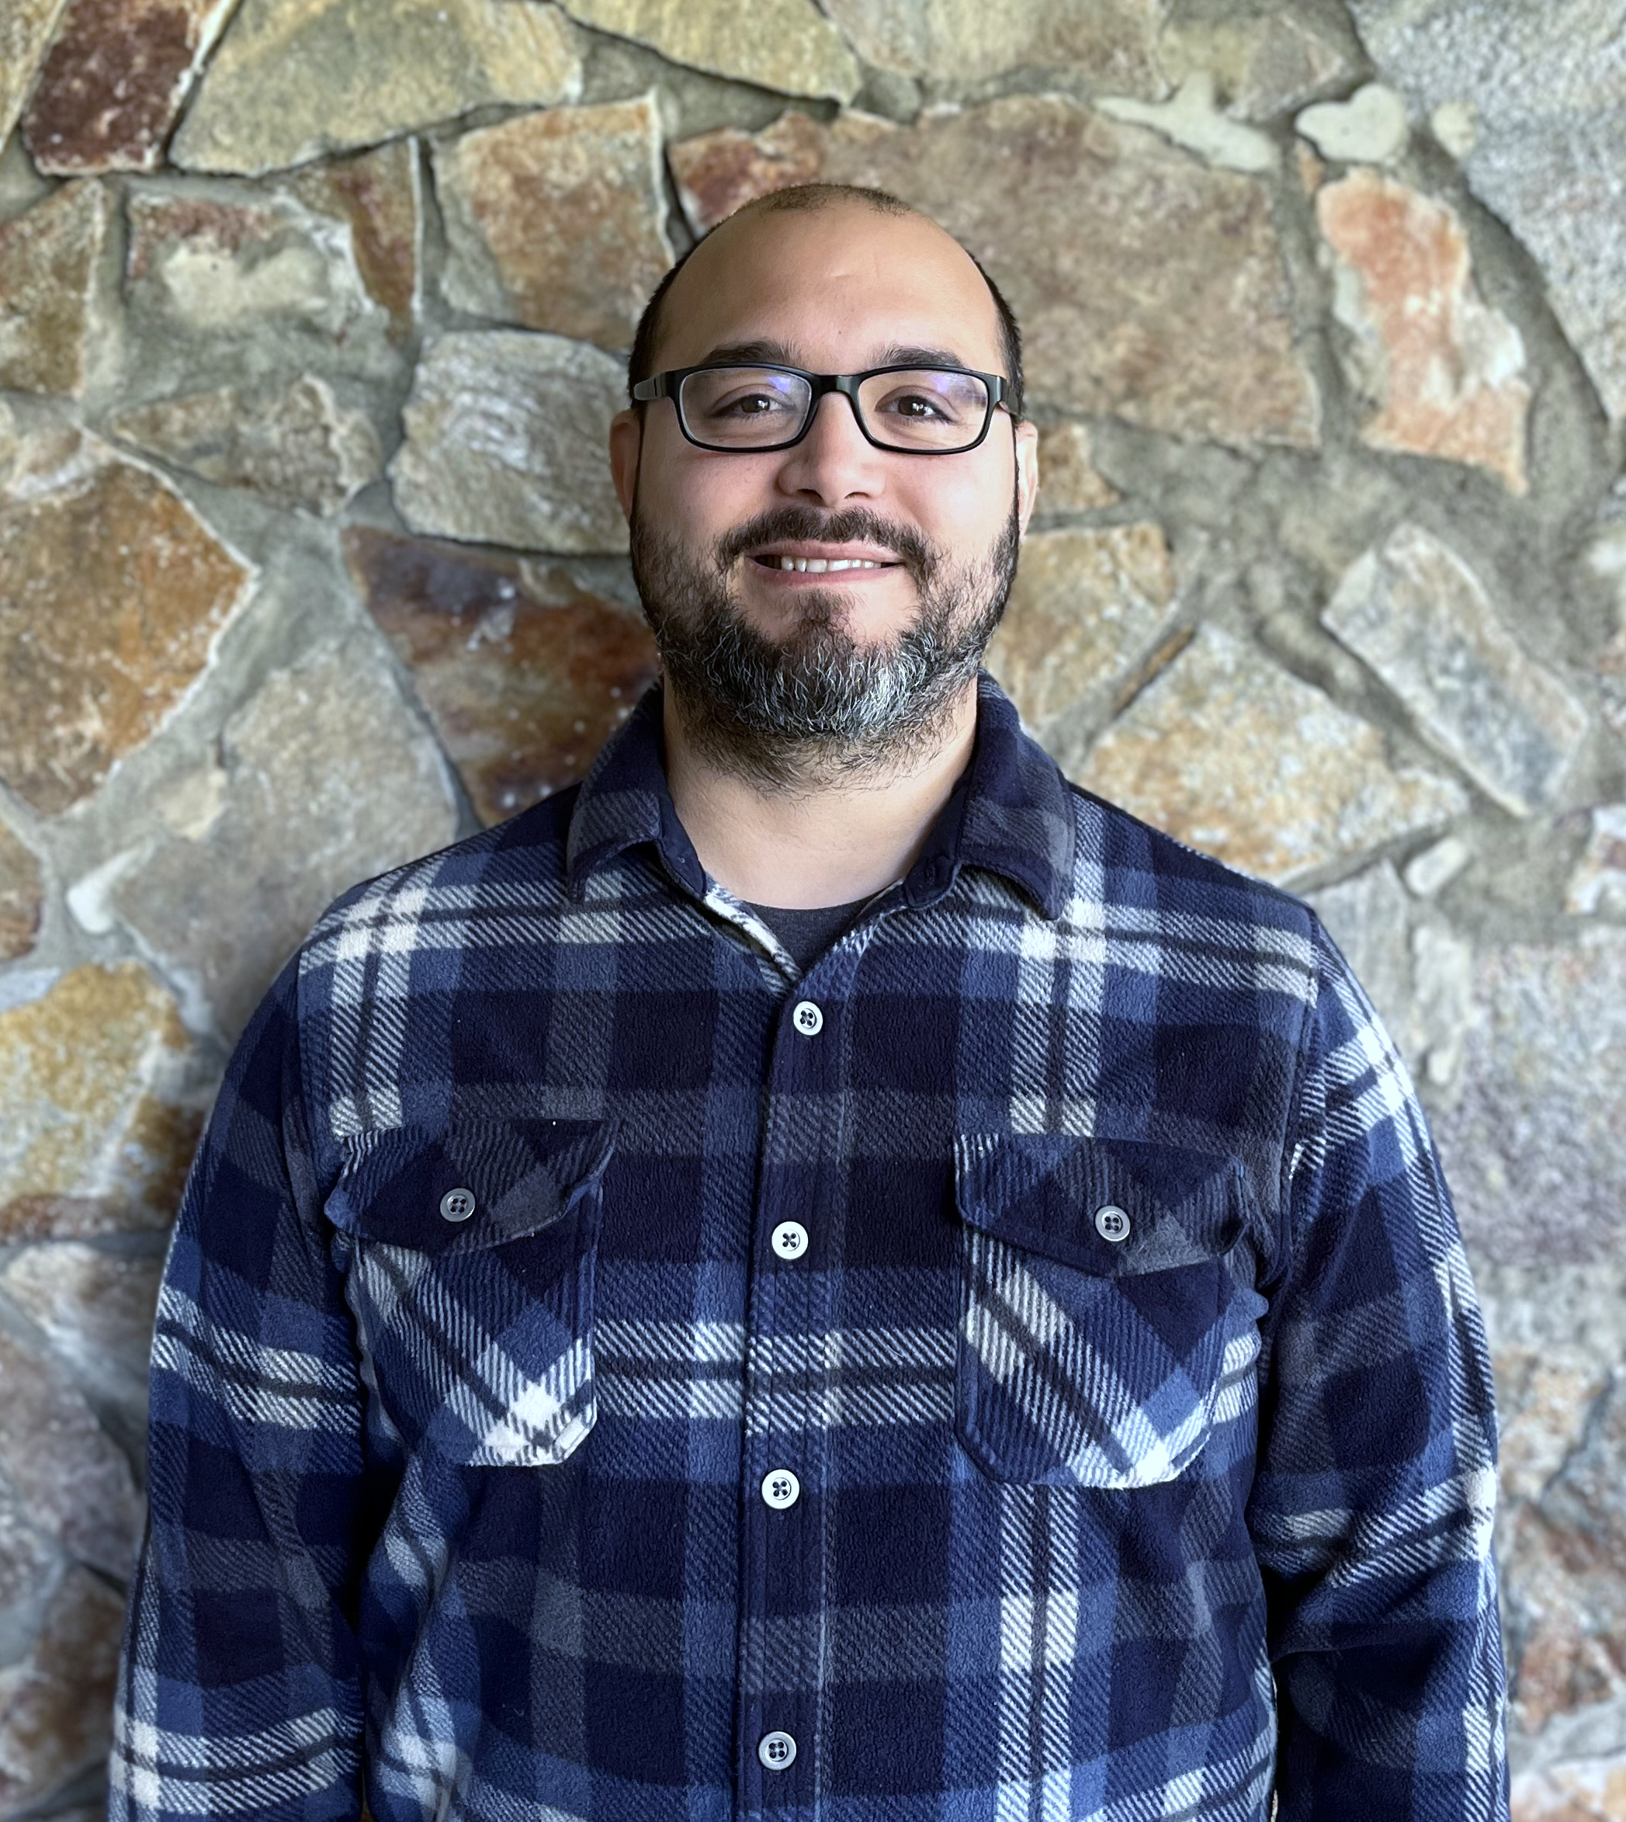





Meet Our Navigators
Chanry Yann
Business, Paralegal, Technology
Dail Rodriguez
Healthcare (Students last name A- R )
Tuyen Huynh
Healthcare (Students last name S-Z), Transfer, Basic Education for Adults,
English Language Acquisition
Marisa Mezs
Early Childhood Education,
Human Services, Bachelor Programs
Adam Meyers- Lead Navigator
Lorrie Ann- Lead Resource & Outreach Navigator
Pwint KoKo- Lead Navigator
Notes:
Check the pathways tittles

Slide 5



Meet Our On-Campus Community Partners
Career Team: Meet with Audrey for assistance with job search, employment, training resources, and connections to WIOA programs, and other resources.
Northwest Education Access: Meet with Haley to explore educational supports and connect with a NWEdA Advocate who can provide guidance and resources tailored to your needs.
United Way- Financial Coach: Meet with Charisma to plan your financial future, focusing on budgeting, expense management, credit building, and savings strategies.
Community Partners On-Campus
Notes:
Need more workstudy Pic

Slide 6
Workforce Education Grants Overview
WorkFirst
Basic Food Employment & Training (BFET)
Worker Retraining
Opportunity Grant
Early Achievers

Slide 7
WorkFirst
Eligibility Requirements
Must Be a Temporary Aid to Needy Families (TANF) Recipient
Must Be Referred from a Department of Social and Health Services (DSHS) Case Manager
Report Weekly Attendance
in Canvas
Workfirst can assist with Professional- Technical Degrees, Certificates, Specific Academic Transfer Programs, and BAS!

Slide 8
Basic Food Employment & Training (BFET) Eligibility Requirements
Must be Receiving Supplemental Nutrition Assistance Program (SNAP)
Cannot be Receiving TANF
Monthly Check-ins and Annual Update of Individual Employment Plan (IEP) are Required
BFET can assist with Professional- Technical Degrees, Certificates, and specific Academic Transfer Programs!

Slide 9
Worker Retraining
Eligibility Requirements
Currently Collecting Unemployment
Collected Unemployment in the Last 4 Years
Discharged from Military Service in the Last 4 Years
Closed a State-licensed Business within the Last 4 Years
Became a Displaced Homemaker in the Last 4 Years and are Low-Income
Worker in Need of Skills Upgrade

Slide 10
Opportunity Grant
Eligibility Requirements
200 % of Federal Poverty Level 2025
Household Monthly Income
Household of 1
Household of 2
$2660.00
$3606.67
Household of 3
$4553.33
Household of 4
$5500.00
Household of 5
$6446.67
$7393.33
Household of 6
Must be a Washington State Resident & Enrolled in a Professional Technical Training Program
Notes:
Update the income!

Slide 11
Early Achievers Grant (EAG)
Eligibility Requirements
Early Childhood Education Program only
Employed at an Early Achievers Participating Facility.
Employed in an eligible role for 3 months prior to the start of the quarter
Eligible Roles: Family Home Owner/Licensee, Center Director, Assistant Director, Program Supervisor, Lead Teacher, Assistant Teacher
Minimum of 10 hours per week or 40 hours per month
Quarterly Employment is verified in MERIT.

Slide 12
Workforce funds may assist with:
Fees
Books
Tuition
Grants are for start-up, gap filling, and dependent on budget

Slide 13


Workforce Education Grants
Summary of Key Points
Not full-degree funding: Workforce grants help start programs or fill gaps (e.g., tuition/textbooks), not cover entire degrees.
Case-by-Case: Assistance is provided based on available funds, demonstrated need, and alignment with program priorities.
Student-driven requests: Funding is not automatic. Students must submit Quarterly Funding Request Form each quarter.
Meeting the eligibility criteria does not guarantee funding every quarter.

Slide 14




Programs of Study Supported by Workforce
tacomacc.edu/help/ineedskillstofindaprofessionalcareer
Information Sessions
Business, Paralegal, Technology Pathways
  Accounting
  Business
  Network and Cyber Security
  Paralegal
Healthcare Pathways
  Allied Health
  Nursing
  Diagnostic Medical Sonography
  Radiologic Science
  Respiratory Therapy
  Emergency Medical & Health Services
  Health Information Technology, Medical Billing Specialist, Medical Scribe Certificates
Education & Human Services Pathways
  Early Childhood Education
  Human Services, Substance Use Disorder Professional Certificate
WorkFirst and BFET Grants can help with specific academic transfer programs such as Business DTA, Computer Science, and more. tacomacc.edu/help/transfertocollege
WorkFirst, Worker Retraining Grant, and the Opportunity Grant may support selective BAS programs.
Notes:
Add a specific transfer program for BFET/ WF

Slide 15


Attend an Information Session
to learn more about programs!
tacomacc.edu/bus-para-tech
tacomacc.edu/healthcareers
Whether you are a new student inquiring about a career in healthcare, business, technology, or are already enrolled at TCC and looking to change pathways, attending a Pathways Information Session is your chance to learn more about the programs we offer. Information Sessions
Notes:
Need to update!

Slide 16
Workforce Education also Supports
Basic Education for Adults (BEdA) & English Language Acquisition (ELA)
tacomacc.edu/academics-programs/basic-education/
High School Completion Programs
Adult Basic Education Classes
English Language Acquisition
Learning Communities: In Learning Communities, two or more of your classes are joined into one, and teachers work together to connect their content and support and mentor you.
Allied Health Exploration: An introduction to the delivery of healthcare services and explore the various Allied Health professions while strategizing and sharing successful strategies for the college classroom, clinical environment, and taking care of your own emotional and physical wellbeing.
Career and College Pathway Academy (CCPA) : Helps students with career exploration and allows them to get college credit in required classes while still completing prerequisites.

Slide 17
Financial Aid
All Workforce Students Must Complete FAFSA or WASFA Each Year.
FAFSA/WASFA
FAFSA- Free Application for Federal Student Aid
WASFA- Washington Application for State Financial Aid
FAFSA & WASFA Completion Assistance:
FAFSA/WASFA Tips
Helpful Hints
Keep in mind
Grants : Free money; no repayment if you maintain academic progress.
Scholarships: Free money; based on merit, need, talent, or field of study.
Federal/State Work-study: Earn aid through part-time work; limited availability.
Loans: Must be repaid with interest.
Complete NOW
Visit TCC Financial Aid website for updates TCC Financial Aid Page
Self- enroll in Financial Aid and Planning Canvas Course
Check Your Student Email Regularly
Monitor your ctcLink, “To Do” list
Complete any requested documents promptly
Submission is only complete once:
Khushnum Sauna
253-722-3429
ksauna@mdc-hope.org
FAFSA/WASFA is submitted
You’ve applied to TCC
All requested documents are turned in

Slide 18
Student Resources
The links below connect you to academic tools, life resources, student events, and more—including guides for ctcLink, Canvas, TCC email, and other online systems.
TCC On- Campus Help
Life Resource- Self Enroll Canvas Course
The Center for Student Advocacy & Cultural support
TCC Career Center
WorkSource Pierce
Workforce Resources Page
Community Partners On-Campus

Slide 19


Complete the Workforce Student Checklist
Complete the Workforce Intake Application
Check in with your Workforce Navigator
To Become a Workforce Student
Workforce Education Department
Building 19- Room 70
Phone:253–566-5188
tccworkforce@tacomacc.edu
tacomacc.edu/workforce

