Slide 1


Tacoma Community College
Workforce Grants & Application Orientation
Contact Information:
Workforce Education Department
Phone:253.566.5188
Virtual Lobby- Assists with General Questions
: Monday, Tuesday, Wednesday 10:00-3:00pm,
Thursday 10:00-5:00pm, Friday 10:00-2:00pm Email: tccworkforce@tacomacc.edu

Slide 2

Adjusting to a Post-COVID World
Navigating New Realities Due to COVID Can Be Difficult​
TCC and Our Team in The Workforce Education Department are Committed to Your Success​
This Presentation is Intended to Familiarize You with:​
Workforce Funding Sources that May Provide You with Additional Financial Support​
Who Qualifies for Workforce Funding​
What You Need to do Receive Workforce Funding if You are Eligible​
And Additional Resources Available to Students at TCC

Slide 3




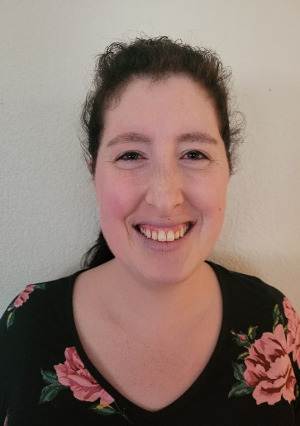

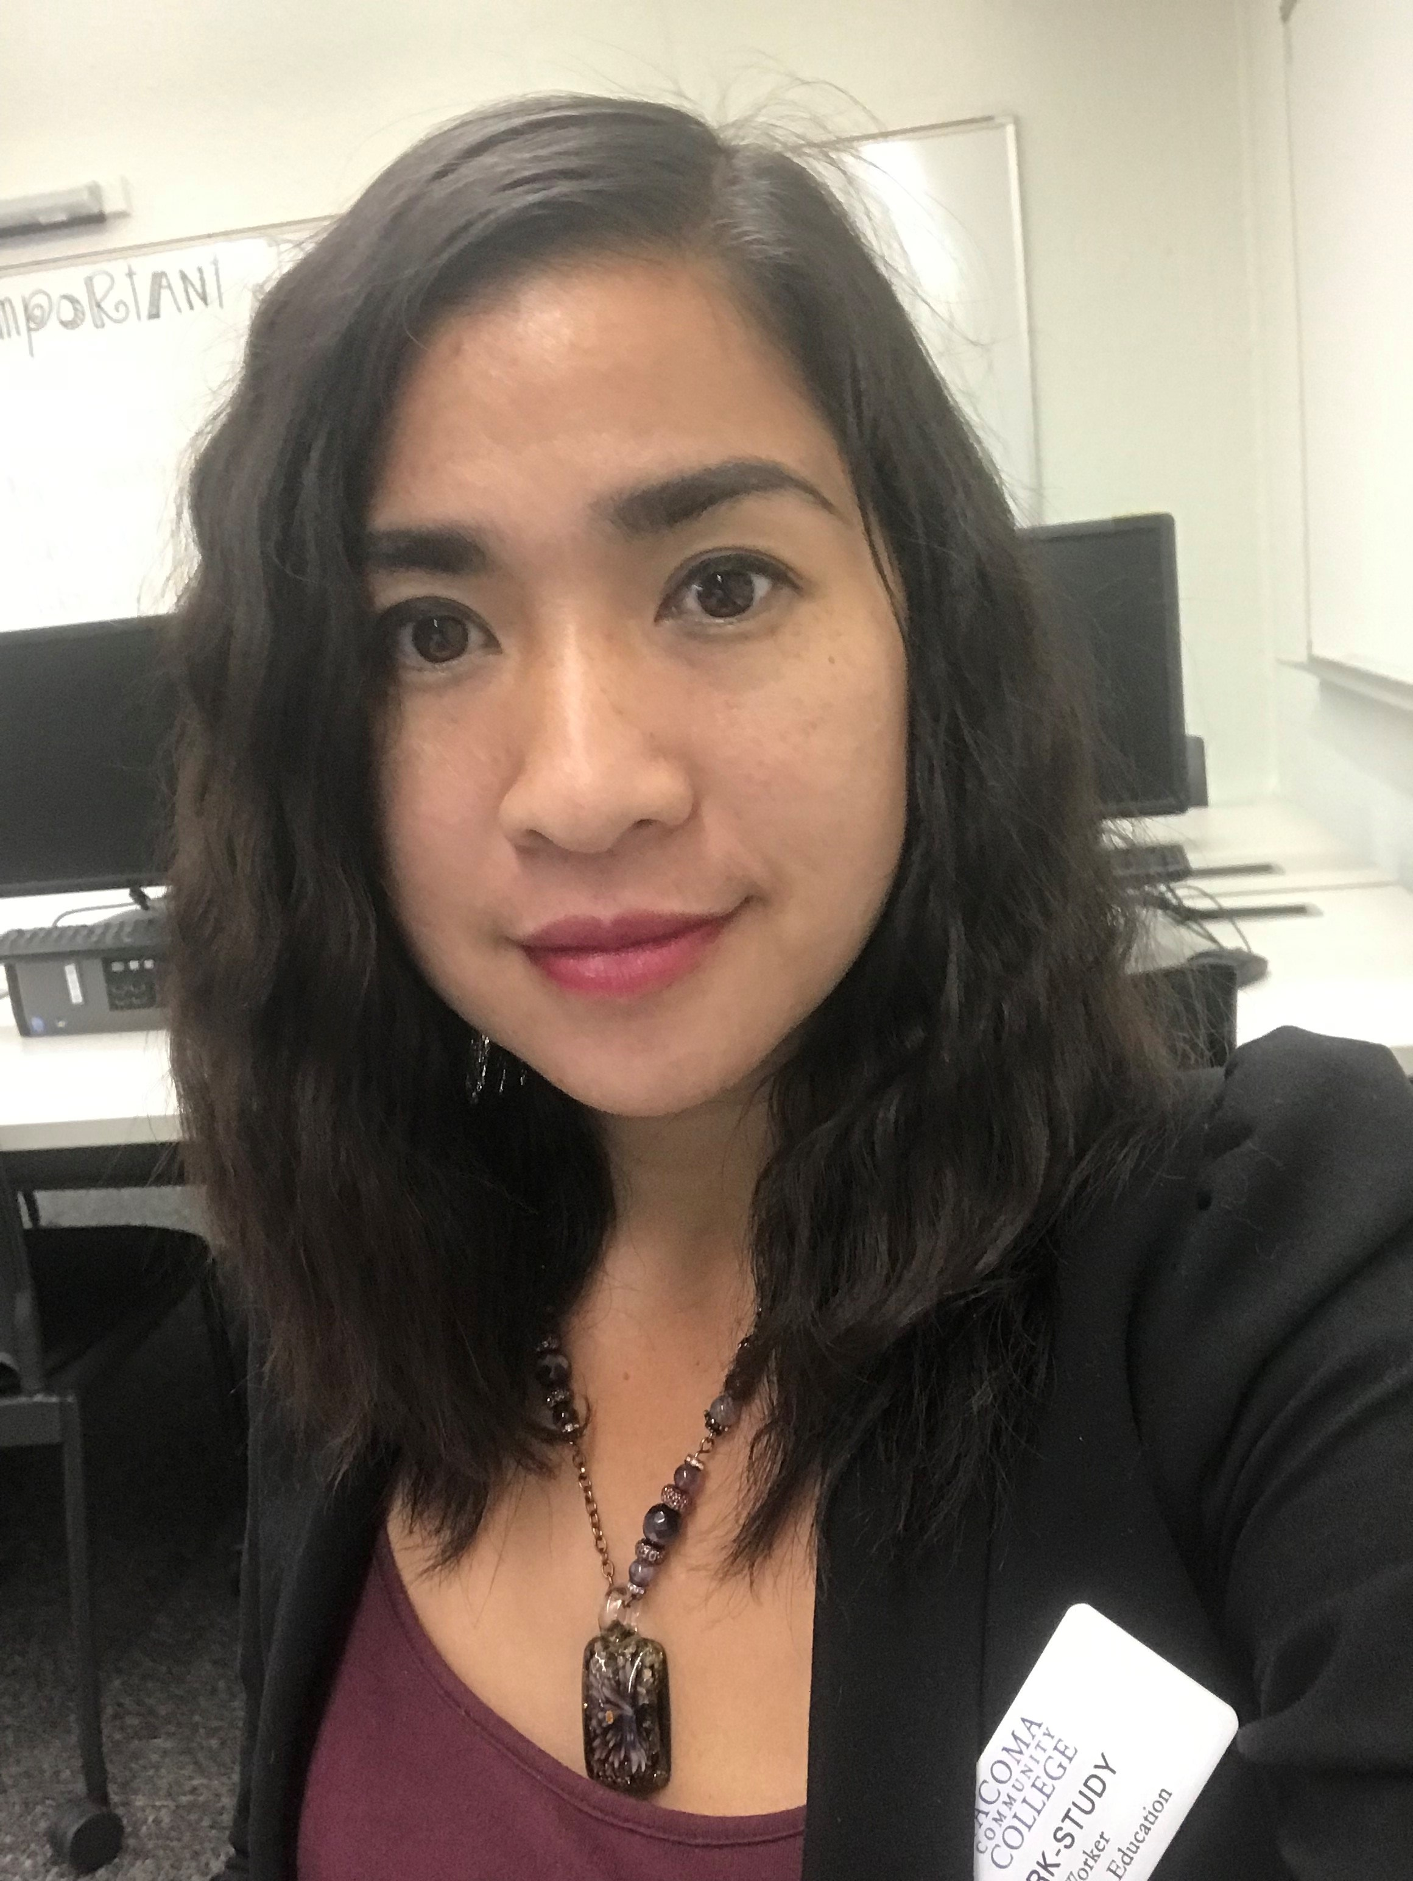
Meet Our Team
Our Staff Includes:
Cassie Knipfing, Workforce Academic Advisor
Tamara Piñero, Office Manager
Jena McNeley, Financial Aid Specialist
Chanry Mondragon, Data Specialist
Our Amazing Work-study Students

Slide 4

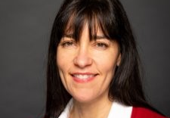

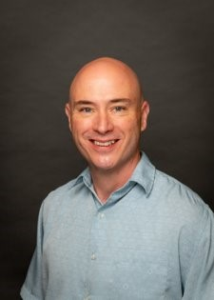


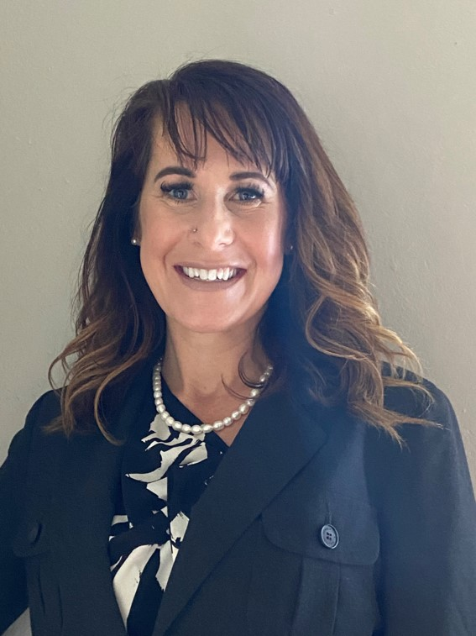
Meet Our Navigators
Adam Meyers Accounting, Business, Networking and Cyber Security, Medical Billing, Health Information Technology, Paralegal, VIE 25
Bethel Wolfe Allied Health (to prepare for selective health programs), Human Services, BAS programs
Angie Christoph Early Childhood Education
Lorrie Anne Outreach, and ESD Questions
Nikki SnowKing ABE, AESL, HS+, Fresh Start, IBEST, CCPA, Nursing, Respiratory Therapy, Radiologic Science, Diagnostic Medical Sonography, Emergency Medical & Health Services
Katrina Roe Intake Navigator
Pwint KoKo Intake Navigator BFET Eligible Transfer Degrees

Slide 5
What Are Workforce Education Grants?
WorkFirst
Basic Food Employment & Training (BFET)
Worker Retraining
Opportunity Grant
Early Achiever Grant

Slide 6
WorkFirst Eligibility Requirements
Must Be a Temporary Aid to Needy Families (TANF) Recipient
Must Be Referred from a Department of Social and Human Services (DSHS) Case Manager
Attendance Must Be Reported Weekly Through Canvas

Slide 7
Basic Food Employment & Training
(BFET) Eligibility Requirements
Must be Receiving Supplemental Nutrition Assistance Program (SNAP)
Cannot be Receiving TANF
Monthly Check-ins with your Workforce Navigator in Canvas are Required

Slide 8
Worker Retraining Eligibility Requirements
Currently Collecting Unemployment
Collected Unemployment in the Last 4 Years
Discharged from Military Service in the Last 4 Years
Closed a State-licensed Business within the Last 4 Years
Became a Displaced Homemaker in the Last 4 Years and are Low-Income
Worker in Need of Skills Upgrade

Slide 9
Opportunity Grant Eligibility Requirements
200 % of Federal Poverty Level 2020
Household Monthly Income
Household of 1
Household of 2
$2127
$2873
Household of 3
$3620
Household of 4
$4367
Household of 5
$5113
Household of 6
$5860
Must be a Washington State Resident & Enrolled in a Professional Technical Training Program

Slide 10
Early Achiever Grant Eligibility Requirements
State Grant for Early Childhood Education Students Who Are:
Working in a Daycare or Pre-school that is Early Achiever Certified
Worked at the Daycare or Preschool for the Last 3 Months
Worked at the Daycare or Preschool for the Last 3 Months for at least 40 Hours per Month
Significant Documentation and Monthly Contact with Workforce Navigator is Required
Students Who Are Awarded this Grant May Also Qualify for the Other Grants Offered By Workforce

Slide 11
What Do Workforce Funds Cover?
Tuition
Books
Fees
Grants are Designed for Start-up & Fill in the Gap Funding Determined Quarterly

Slide 12
What Programs of Study Does Workforce Fund?
Prerequisite Classes
High School Diploma Classes
Adult Basic Education Classes
I-Best
Professional
Technical Degrees
ESL Classes
We May Be Able to Fund Additional Programs, Such as Transfer Degrees if You Qualify for the BFET Grant.
Ask Your Navigator If You Have Questions

Slide 13
Integrated Basic Education Skills Training (I-BEST)
Career And College Pathway CCPA Academy
Emergency Medical Technician
Help Desk
_______________________________________________
Early Childhood Education
Nurse Assistant-Certified
For I-BEST CNA and Early Childhood Education Enrollment
Contact
Elizabeth Stewart
estewart@tacomacc.edu
253-460-4453
For I-BEST for EMT and Help Desk Enrollment
Contact
Alicia Peebles
apeebles@tacomacc.edu
253-566-5375

Slide 14
Financial Aid
FAFSA
Free Application for Federal Student Aid (FAFSA)
FAFSA Tips
Helpful Hints
Check Your Student Email and CTC Link, “To Do” Box Closely Follow-up with any Additional Needed Actions
Be Aware
Avoiding Loans Can Be the Key to Success
All Workforce Students Must Complete The Free Application for Federal Student Aid Each Year
Complete Application By Priority Deadline, or as Soon as Possible
Use the IRS Data Retrieval Tool When Completing Your FAFSA
Check Out Important Information About Financial Aid at TCC Online
Ask Your Navigator About Financial Literacy Community Resources

Slide 15
Working While Attending School
Options to Consider
Apply for Federal or State Work Study Positions
Employment Resources
Look for Part-time Work in Your Field of Study if Possible
Career Center
WorkSource Pierce
Check the Box on Your FAFSA
Make an Appointment with Career Center Coordinator, Natalie Wilkerson, on the TCC Career Center Website
Offers Many Resources in Finding Employment Assistance Available on WorkSource Website

Slide 16
Student Services
TCC Makes a Commitment to Every Student that No Matter Where You Start or What You Hope to ​ Achieve, We Will Educate and Support You, and Provide You with Opportunities to Help Meet Your Goals
Please Visit Our Website TCC Help Center to Learn More and Get Linked to Services
TCC Help Center Website
Academic Advising Zoom Lobby
CHAP Housing Assistance
Emergency Financial Grants
Laptops
Resource Directory
Food Pantry
Counseling
Technical Assistance
Tutoring Schedule a Virtual Appointment
Your Workforce Navigator
Access Services Support for Those Needing Accommodations

Slide 17
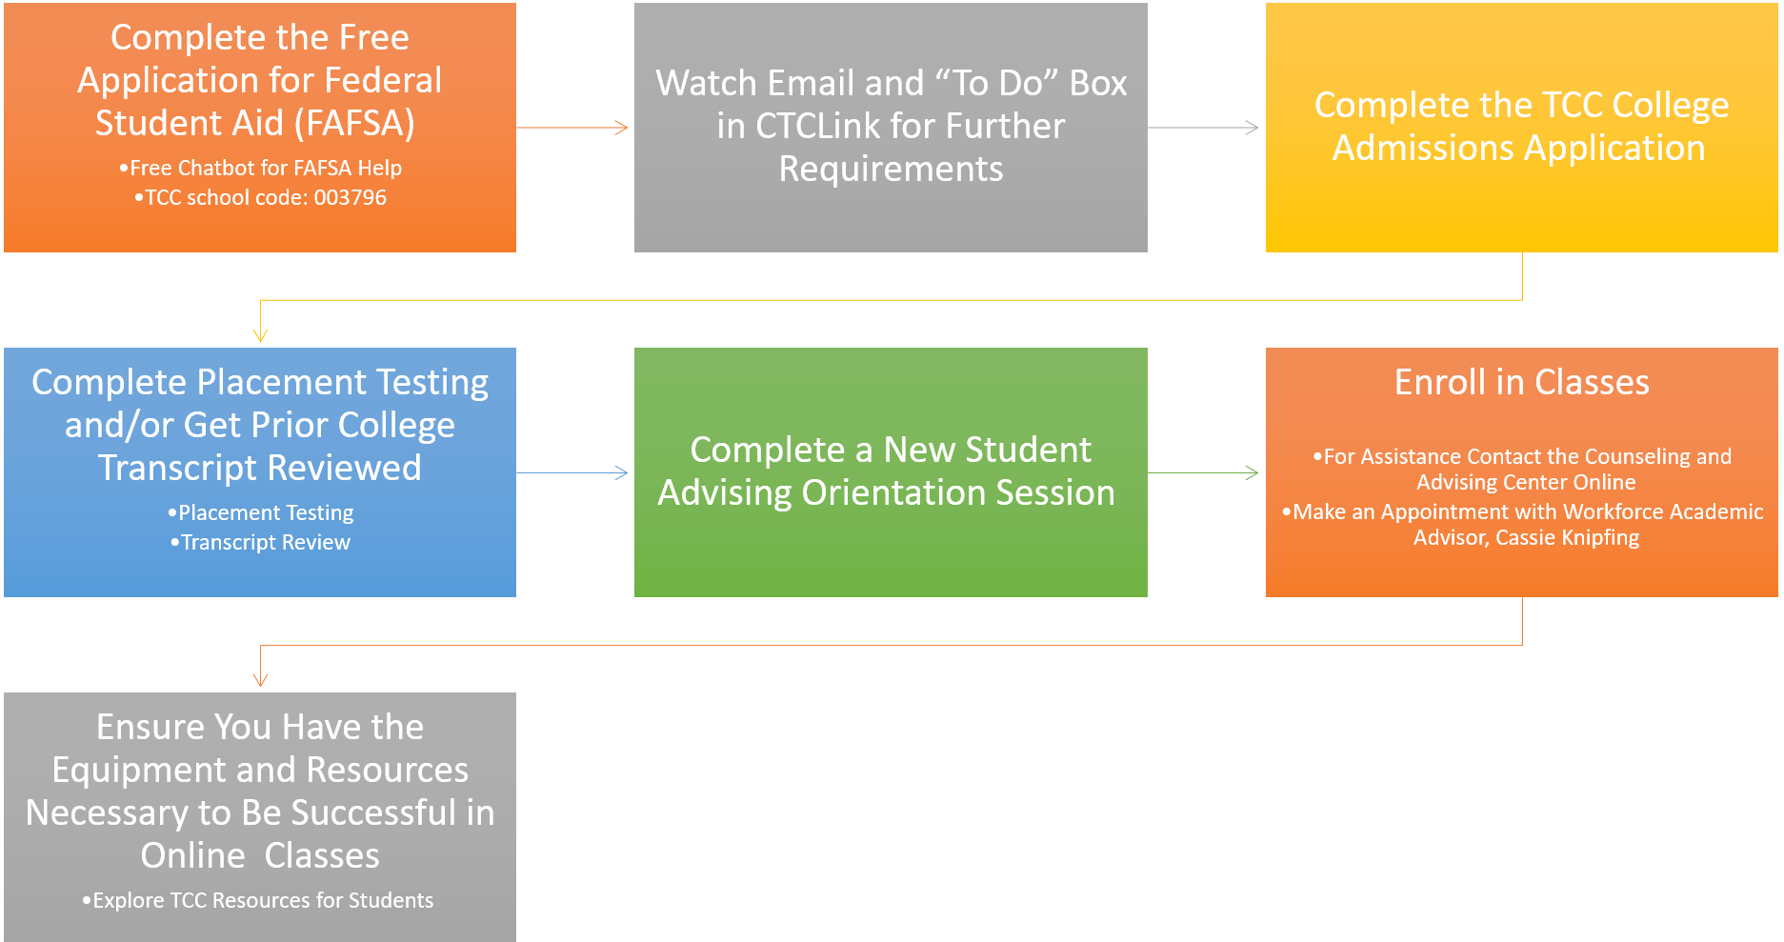
Steps for All New Students

Slide 18
Establishing Workforce Program Eligibility
Provide: Documentation For Worker Retraining, If Applicable
Unemployment Insurance Check Stub
Or Go To Employment Security Website
Provide: Divorce/Separation/ Death Decree, If Applicable
Spouse’s UI Documents
Displaced Homemaker Attestation Form, Provided By Navigator
Provide: DD214, Discharge From Military Service, If Applicable
Apply For: Basic Food Assistance, If Appropriate
WashingtonConnection.org
Indicate You Want to Be On BFET at TCC In the Comment Box
Complete The FAFSA Application
877-501-2233
Call 2-1-1
www.washingtonconnection.org
Please Email Supporting Documents to Workforce Front Desk
tccworkforce@tacomacc.edu

Slide 19
Steps To Receive Workforce Funding
Schedule an Appointment with a Navigator to Get the Quarterly Funding Request Form
Complete the Workforce Quarterly Funding Request Form By Tuition Due Date
Spring 2021 Thursday Mar 11, 2021
Check your Student Email Account Regularly
Look for Critical Messages from Your Workforce Navigator
They Will Give You Updates Regarding Tuition Payments & Bookstore Accounts

Slide 20
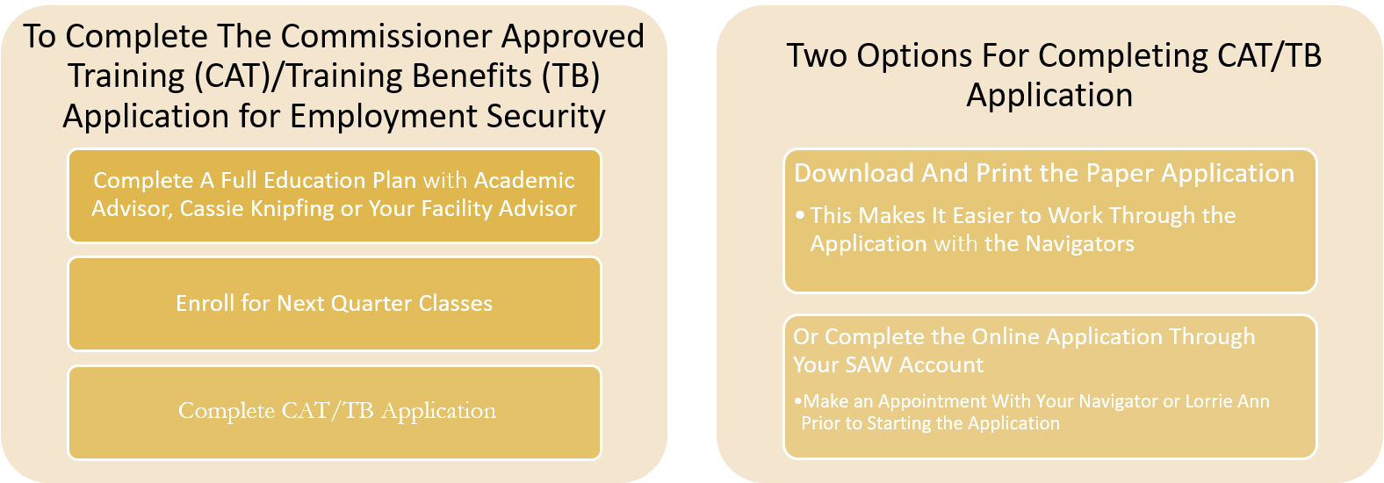
Steps for Students Receiving Unemployment Insurance (UI) Benefits

Slide 21
Steps to Take After the Quarter Starts
Check Your Student Email Regularly
Accept Canvas Invitation to Workforce Community
Meet with a Workforce Academic Advisor, Cassie Knipfing, or Faculty Advisor, to Create an Education Plan
A Three-quarter Plan is Sufficient
An Education Planning Learning Module is Available in Canvas
To Request Continued Workforce Funding Next Quarter
Enroll in Classes
Complete the Quarterly Funding Request Form Before Tuition Due Date
The Workforce Funding Request Form Will be Available in the Workforce Community Page in Canvas

Slide 22
Time to Begin Your Workforce Intake Application & Checklist
Complete the Workforce Student Checklist
Complete the Workforce Intake Application
The Link to the Intake Application & Checklist Can Be Found in Your Workforce Orientation Web Page
To Become a Workforce Student
Contact The Workforce Education Department If You Need any Assistance
☎ 253.566.5188
Our Virtual Lobby Can Assist with General Questions
Monday, Tuesday, Wednesday 10:00-3:00pm, Thursday 10:00-5:00pm, Friday 10:00-2:00pm
Email: tccworkforce@tacomacc.edu

