Slide 1
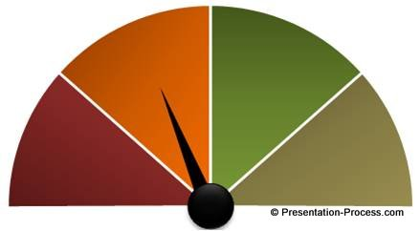
Moving the Needle:
Where Coding Meets Quality
Toni McKay, RHIA
Program manager, Accreditation
Swedish Medical Center

Slide 2
Welcome
  Objective
    Demonstrate the impact of coding on quality initiatives (and the subsequent impact on reimbursement, public perception, and contracting)
  Today we will
    Review examples of different initiatives that rely on accurate coding
    Follow the downstream effects when coding impacts performance in these metrics
    Take a deep-dive into a measure where on Swedish facility (Swedish Edmonds) was able to “move the needle”
    Discuss how a successful partnership between quality, coding, CDI and providers was established at Swedish Edmonds
  At the conclusion, you will
    Be familiar with some of the quality programs impacted by coding data
    Be able to describe a successful partnership between the quality and coding departments
Notes:
How many of you are coders? You know what you do is important, but do you truly appreciate the far reaching impact of the work you do? There is a multitude of uses for coded data, such as clinical research, population health, disease maintenance, registries (i.e. tumor, trauma, birth defects, etc.), physician credentialing and privileging, as well as volume statistics for activities such as payor contract negotiations, market share analysis, and transparent pricing
Maybe some action items if you want to start building that relationship

Slide 3

Introduction
  Who am I
    Over 25 years experience in the HIM field
    Various settings including home health, hospice, surgeon’s clinic, behavioral health, integrity & compliance
    Currently Program Manager in the Accreditation Department
      Disclaimer – I developed this presentation while a member of the Quality Department. Some measures may have changed, but core concepts still apply.
  Why I chose this topic
    Coding staff should know the wide-spread impact of the work they do
  Swedish Edmonds
    216 bed hospital in Edmonds, WA
    Part of the Swedish Health system, affiliated with Providence Health System
    Currently separate (but affiliated) quality department, HIM Department and medical staff
Notes:
Without drilling down- there is a layer of fog over metrics
When cases are mis-coded, rates are inaccurate and you can loose trust
CDI is not part of HIM
Big fish-little fish

Slide 4
Important Disclaimers
Many reasons for code changes
Data entry error
Opportunity for coder education
All changes are made within coding guidelines
The goal is accurate documentation and coding
All code change requests are approached as a collaboration with respect for the coders expertise regarding coding rules
Physician documentation
Today’s information is an overview
This information is meant to illustrate the power of correct documentation and coding
Not meant to provide guidance on specific measures discussed
Notes:
When I said “mis-coded” I’m not specifically talking about coder error. This is about the entire information flow
What kind of power partnering up to explore the data can have

Slide 5

There are many Quality Initiatives that Depend Upon Coded Data
Reimbursement Impact (beyond patient claims)
  Hospital Acquired Conditions (CMS)
    Lowest quartile hospitals will be subject to a 1% payment reduction
  Value Based Purchasing (CMS)
    2% “hold back” with hospitals having the ability to earn back based on performance
  Readmissions Penalty (CMS)
    Potential of 3% penalty if your readmission rate is higher than expected med
  Medicaid Incentive Program (Medicaid)
    Hospitals meeting quality threshold can earn a 1% incentive payment
Notes:
We will look at impact besides financial - but of course monetary impact is where you can get attention (and resources)
Note: this is a percentage of all reimbursement- not just on any particular case
Tsunami slide
HHS timeline that hopes to see 90% of traditional Medicare payments transformed into value-based reimbursement

Slide 6
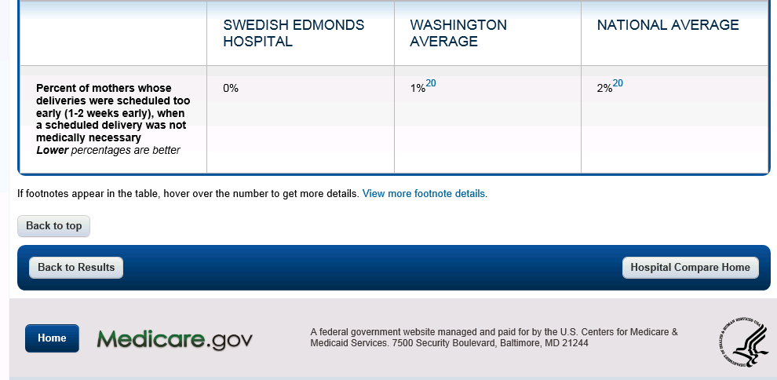
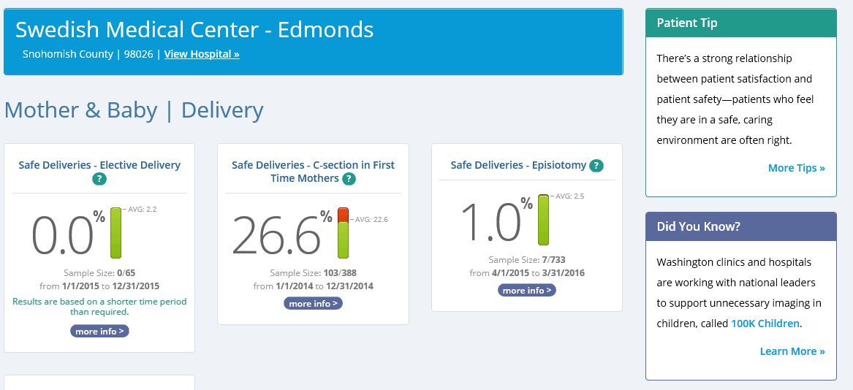
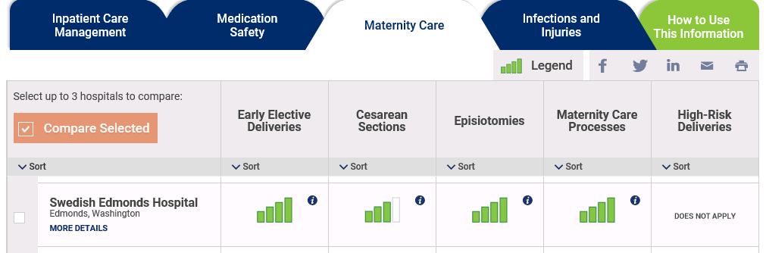
Publically Reported Data
Notes:
Just some examples- many more (WSHA)
Ripple effect- CMS measures are re-reported --- double dipping

Slide 7
Current Trends
Contracting
  More private payers are using quality metrics for decision making and rate setting
Automation
  Quality data is moving away from manually collected and self reported data towards coded, automated or claims based data
Notes:
In the old days of core measures, abstractors actually read the chart. If something didn’t look right, they could questions or fix. With Ecqms- it is automated and “out the door”

Slide 8

It is a moving target
Measures are constantly being added and retired- and definitions change
Work with Quality Department and senior management to determine which measures to focus on
Efforts to ensure appropriate documentation and coding are never wasted
Notes:
Some metrics presented here may have changed
CMS loves to make a rule, then as soon as everyone meets it- OK that is now retired
A more recent game they like to play is “here is a new quality metric” and we are going to base your performance on last years claim data (before we told you the rules of the game) so baselines are often already past

Slide 9



Early Elective Delivery
What is Measured
  Mothers who are delivered prior to 39 weeks without going into labor on their own (and without having a medical reason for early delivery)
Impact
  Value Based Purchasing
  Washington State Medicaid Initiative
  http://www.wahospitalquality.org
  Medicare Hospital Compare
Case Study
  A mother was admitted with premature rupture of membranes. Code O4212 not assigned.
Notes:
Without this code, this case was counted as an early elective delivery

Slide 10

NTSV Cesarean Section Rate
What is Measured
  Cesarean Section rate in NTSV (Nulliparous Term Singleton Vertex) deliveries
Impact
  Washington State Medicaid Initiative
  http://www.wahospitalquality.org
Case Study
  Not including Z370 (Single live birth) on coding profile will not add the patient to the denominator. An inaccurately small denominator will create a higher C-section rate.

Slide 11

Falls and Trauma
What is Measured
  Patients who suffer a hip fracture after admission to the hospital
Impact
  Value Based Purchasing
  Hospital Acquired Conditions
  Medicare Hospital Compare
Case Study
  Patient with peri-prosthetic fracture in the setting of a recent TKA. This was documented in the ED note on arrival, but fracture was coded as POA-”N”

Slide 12

Postoperative Respiratory Failure
What is Measured
  Patients with respiratory failure after a procedure, not present on admission
Impact
  Value Based Purchasing
  Hospital Acquired Conditions
Case Study
  Physician documented “Post-operative respiratory failure”, although the patient underwent surgery, the respiratory failure was not directly related to surgery. Medical Director of Surgical Quality reviewed case and consulted with documenting physician. Encouraged documentation of “Acute Respiratory Failure, due to …” when unrelated to surgery events.

Slide 13
Postoperative Respiratory Failure
Cont.
Distinction
  Post-op respiratory failure is about cause- not simply about timing
Example of post-op respiratory failure
  Patient with long operation who needs lots of IV fluids in trendelenburg position without baseline lung or cardiac disease
Example of acute respiratory failure due to volume overload
  Person with CHF who gets normal IVF but develops pulmonary edema after uncomplicated operation

Slide 14
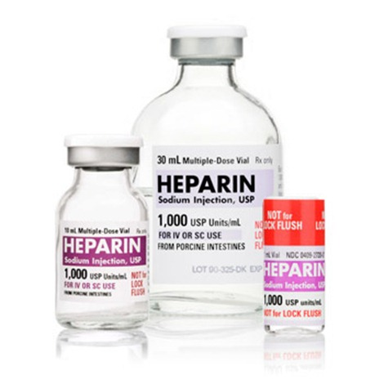
Perioperative
PE/DVT
What is Measured
  Patients with Deep Vein Thrombosis after a procedure, not present on admission
Impact
  Value Based Purchasing
  Hospital Acquired Conditions
Case Study
  Testing revealed a DVT 2 days after admission. Physician did not document whether present on admission. Upon query, physician was able to confirm and document that condition was thought to be present upon admission.

Slide 15

Pressure Ulcers
What is Measured
  Patients who have a new pressure ulcer after admission to the hospital, or a pressure ulcer that increases in staging during admission
Impact
  Value Based Purchasing
  Hospital Acquired Conditions
  Medicare Hospital Compare
Case Study
  Pressure ulcer documented, but physician did not document whether present on admission. Upon query, physician was able to confirm and document that condition was thought to be present upon admission.
Notes:
Additional note: also nursing databases that track this metric, however these are more time-sensitive (first 24 hours of admit)

Slide 16

CAUTI/CLABSI
What is Measured
  Patients who develop a Catheter Associated Urinary Tract Infection or a Central Line Associated Blood Stream Infection during admission
Impact
  Value Based Purchasing
  Hospital Acquired Conditions
  Medicare Hospital Compare
Case Study
  Patient presents with signs of infectious process during admission. Has central line. Initially coded as a central line infection, however upon query, physician states that source of infection is not thought to be central line.

Slide 17

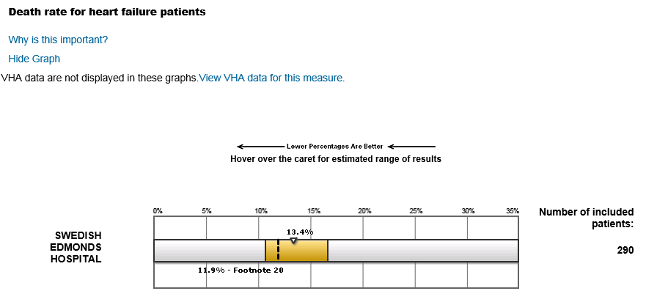
Mortality Rates
What is Measured
  The percentage of patients who die within 30 days after hospital admission for certain conditions
Impact
  Value Based Purchasing
  Medicare Hospital Compare
Case Study
  Mortality statistics are based on an expected vs. observed rate (how many patients were expected to die based on diagnosis, severity etc.) Appropriate use of the code for palliative care when a patient is on comfort care, increases the expected mortality rate

Slide 18

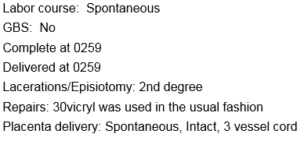
Episiotomy Rate
What is Measured
  Percentage of women giving birth vaginally who have an episiotomy performed
Impact
  Value Based Purchasing
  Hospital Acquired Conditions
  Medicare Hospital Compare
Case Study
  Delivery note template led some coders to assign an episiotomy code when an episiotomy was not actually performed
Notes:
This is an example of “trust” issue. When I first took the episiotomy rate to our OB committee they disregarded I had the time to work with them and with coders

Slide 19

Sepsis
What is Measured
  Appropriate interventions for patients with severe sepsis or septic shock
  Patients who develop sepsis after a procedure
Impact
  Value Based Purchasing
  Hospital Acquired Conditions
  Medicare Hospital Compare
Case Study
  Physician documents “Sepsis” when patient truly only meets SIRS criteria.
Notes:
This is a can of worms. Have physicians and coders been incentivized to document and code sepsis?

Slide 20

Let’s take a deep dive into ... Accidental punctures and lacerations

Slide 21

Accidental Punctures and Lacerations
What is Measured
  Patients who encountered an accidental puncture or laceration during a procedure.
Impact
  Value Based Purchasing
  CMS Hospital Acquired Condition Program
  Medicare Hospital Compare
Case Study
  Difficult bowel resection resulted in an enterotomy, coded as an accidental puncture.
Notes:
Language of the physician as well as training of the coder contributed to over-use of the accidental puncture code.

Slide 22
Swedish Edmonds Hospital Performance
PSI-15 Accidental Puncture and Lacerations

Slide 23
What did we do?
Enlisted a physician champion to review all PSI 15 cases (Medical Director of Surgical Quality)
Physician performed research and worked with coding manager/CDI to understand coding rules
Physician attended a coding staff meeting where he presented “Accidental Puncture and Laceration-When is it an Accident?” which discussed surgeon philosophy, training and language [accident vs. inherent or intrinsic to a difficult operation]
Notes:
Literature search

Slide 24
What did we do? (Cont.)
Physician educated fellow surgeons regarding language choices for operative reports, to allow for better clarity for coders (Language is powerful)
Continued to monitor PSI 15 cases for appropriate documentation and coding with provider/coder education as appropriate
Followed up on cases with true complications
Fortunately these were few and far between once the correct cases were being captured!

Slide 25
Interventions
Notes:
It is very common for significant improvements in metrics to be due to “cleaning up the data”

Slide 26
Swedish Edmonds was Fortunate
Quality Management located near HIM
Quality Manager with HIM background
Engaged CDI Staff
Useful data tools
Collaborative Coding Manager
Physician Champion

Slide 27

The most powerful element- The Physician Champion
Has dedicated time for quality projects
Clinical expertise
Peer to peer communication
Speaks the provider’s language/understands their perspective
Notes:
Mitigates the “us” vs. “them” that you may need to overcome at first
Come up along side them

Slide 28

You need the right tools
You can’t improve the data if you can’t analyze it
May be published reports (after the fact) or internal reports (preview/monitoring)
Monitoring reports may be from external software or within EMR
Notes:
Without data “you surgeons have too many accidental punctures, what is going on??!!!” Once we analyzed the data, we realized it was a documentation/coding problem, not a care problem
Will vary whether you want to invest in prospective mining or retrospective review. You will also have to judge if you want to correct/clean up, or educate going forward (depends upon current rate, impact, age of case etc.)

Slide 29
Building a successful partnership
Build trust slowly
Focus on one measure at a time
Start with case specific feedback
Then find opportunities for global education
Notes:
Did not happen overnight. Educate/give background during the early development “this case currently falls into an early elective delivery population- but the addition of this code (appropratley) takes it out of that

Slide 30
Building a successful partnership (cont.)
It takes a village, for optimal results involve
  Quality
  Coding
  CDI
  Physician champion
  Perhaps even IT/clinical informatics

Slide 31
Building a successful partnership (cont.)
Keep a collaborative attitude
  We are all in this together- focus on accurate and appropriate documentation and coding
  Avoid punitive approach
  Key elements are collaboration, communication and respect
  Partnerships may need to be built slowly-it takes time to build trust
  Effective partnerships understand and respect each member’s expertise
Notes:
It is important to understand impact, but the common goal is appropriate documentation and coding
The great thing is that once you educate (whether it is a physician or coder or CDI)– it snowballs

Slide 32

What might be holding you back?
Overwhelming number of measures
Pick just one to start with
No Partnership between coding/CDI/Quality
Reach out- start with case by case discussions
Lack of a physician champion
Chiefs of staff
Non-Collaborative personalities
Find people you can work with (even if not all roles represented)

Slide 33

What happens with improved metrics?
Financial benefit
Improved public profile
Increased trust in the metrics
Ability for leadership to truly evaluate and address quality
Notes:
So what I hoping you will do from here. At the bare minimum if you walk out of here with a increased sense of “wow, I play a huge role in the quality activities of my hospital” Yay! Hopefully after this information, if you are approached to review codes and you remember this information and go “oh yeah, I understand why you want to discuss this” –Bonus! If one of you goes back to your hospital and actually reaches out to the quality department, or to a committee that might be impacted by your data (maybe you code the OB charts, so you talk to the OB director) and says “hey, I know that sometimes documentation and coding can impact your C-section rates (episiotmy rates, SSI rates). Let me know if you ever want help drilling down the cases to make sure everything is documented and coded correctly.

Slide 34
Thank You
Questions?:
Toni.mckay@Swedish.org

