Slide 1
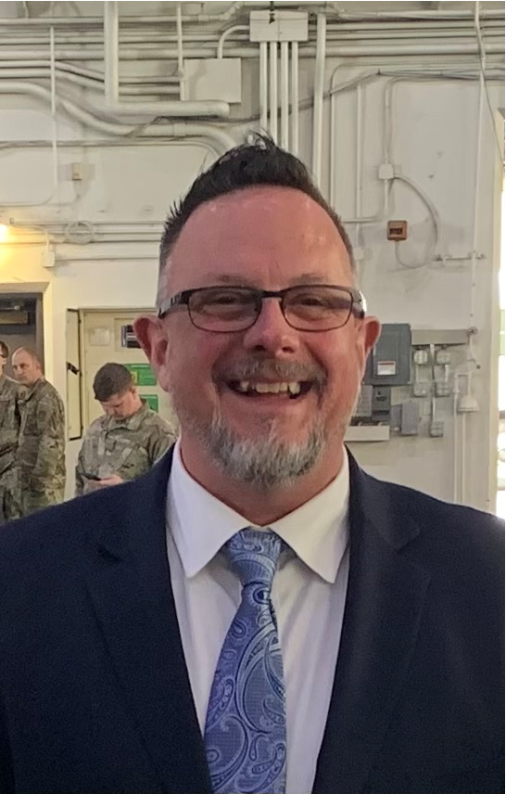
Bruce Smith, Manager Field Operations for Alaska,
Idaho, Montana and Utah
Works for a company which supports the Department of Defense (DoD)

Slide 2
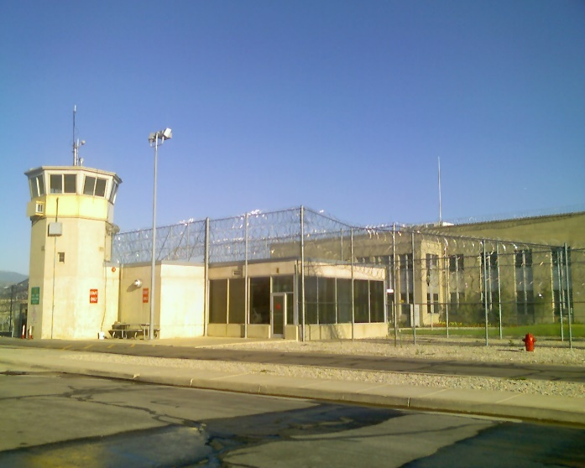
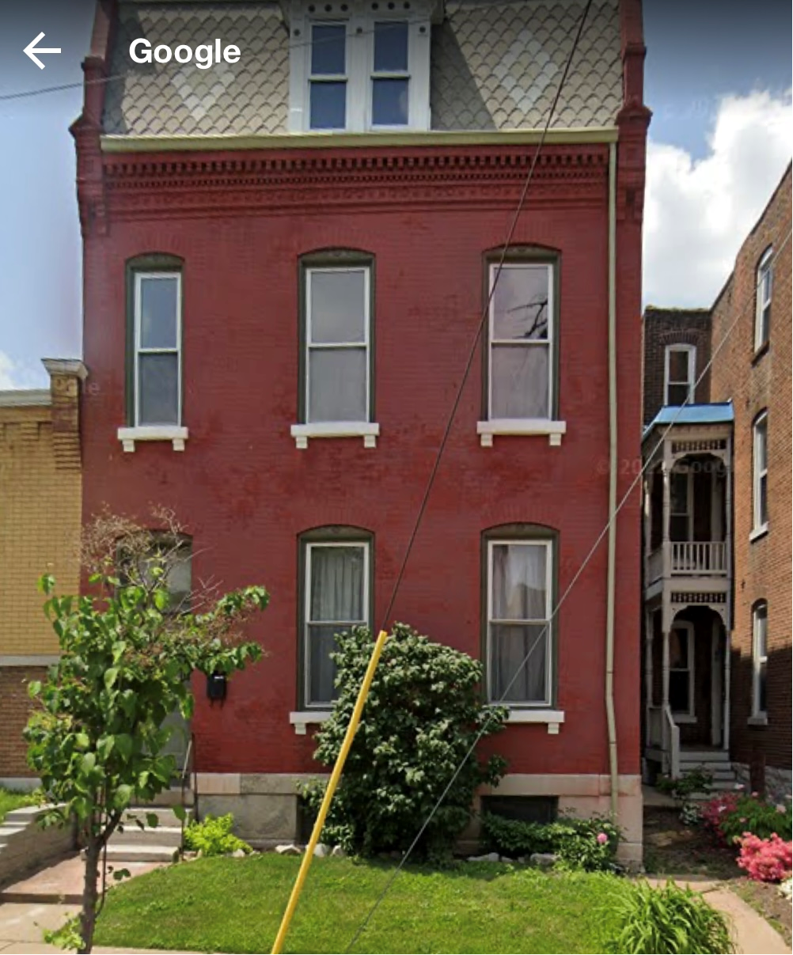
The beginnings

Slide 3
Early Education
Notes:
Both Amy and I went to Community Colleges.

Slide 4
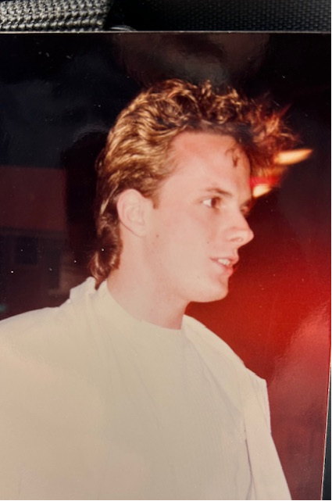
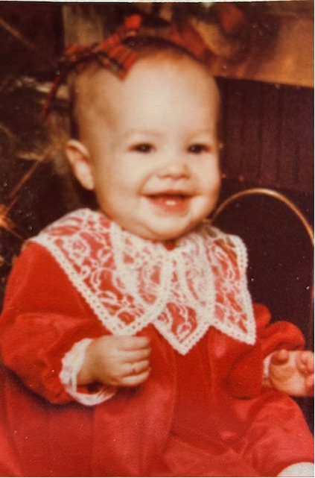
The 80’s

Slide 5
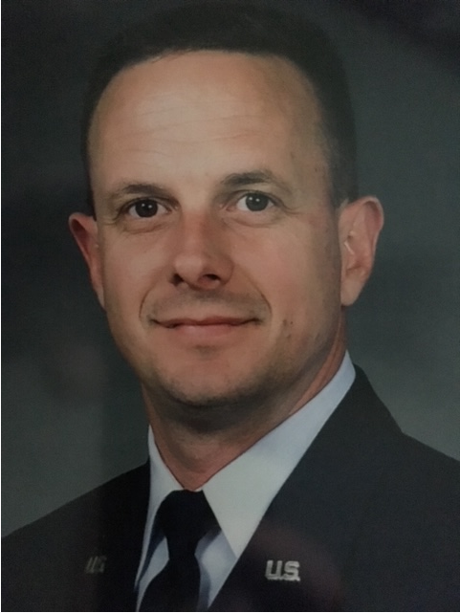
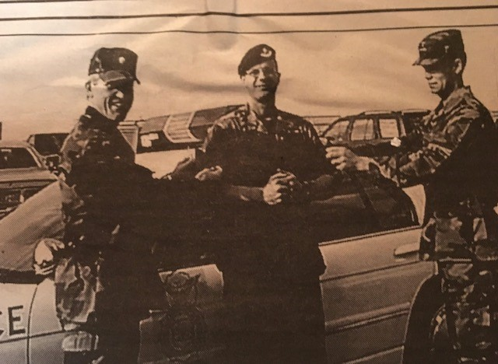
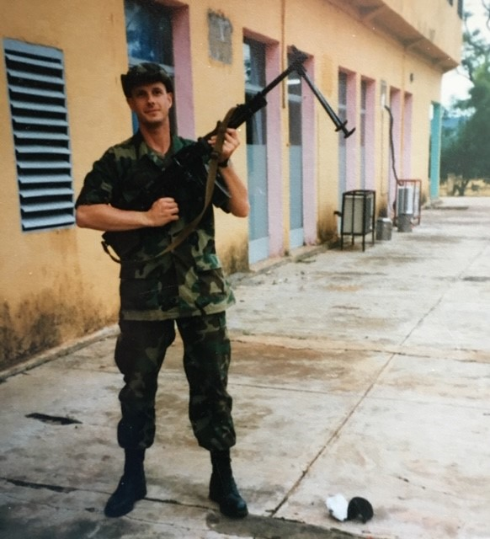
My Military Career (1987-2007)
Health Care Management (4A0) Force Manager (2005), Pentagon, D.C.
Superintendent, Clinical Medicine Flight (2002), Little Rock AFB, AR
Continuing Development Course (CDC) Writer (1998), Sheppard AFB, TX
Security Forces (3P), (1998), Sheppard AFB, TX
Health Care Management 4A0 Instructor (1998), Sheppard AFB, TX
Assistant Administrator (1994), Ramstein Air Base, Germany
NCOIC, Medical Readiness (1991), Lajes Field, Azores Portugal
Assistant NCOIC, Resource Management, (1987), Mather AFB, CA
Resource Management Clerk (1987), Mather AFB, CA
Outpatient Records Clerk (1987), Mather AFB, CA

Slide 6
I got the feeling (2005) and Retirement from the military (2007)
Spouse: Amy Conrad-Smith (better half)
18 plus years together

Slide 7
Work 2007 - 2019

Slide 8
Work 2019 - Present
Managed Care Support Contractor (MCSC) TRICARE West Region,
company who supports the Department of Defense (DoD)

Slide 9
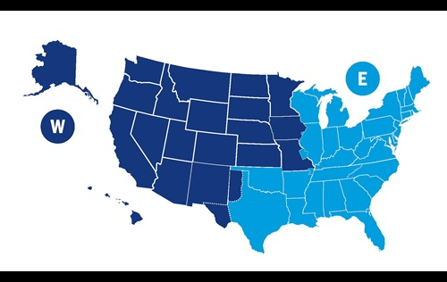
Manage Care Support Contractor (MCSC) West Region
The regional contractors provide health care services and support beyond what's available at military hospitals and clinics for all health plan options and manage administrative support services for the TRICARE benefit. This includes managing enrollment services, maintaining civilian healthcare networks, operating call centers, and processing TRICARE claims.
The company I work for manages the TRICARE Contract for the West Region (dark blue), and another company manages the TRICARE Contract for the East Region (light blue).

Slide 10
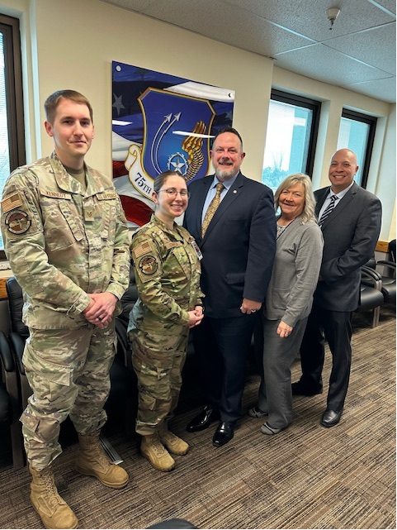
What is TRICARE?
TRICARE is the uniformed services health care program for active-duty service members (ADSMs), active-duty family members (ADFMs), National Guard and Reserve members and their family members, retirees and retiree family members, survivors, and certain former spouses worldwide controlled the Department of Defense (DoD) and Defense Health Agency (DHA).
TRICARE brings together the health care resources of the Military Health System—such as military hospitals and clinics—with a network of civilian health care professionals, institutions, pharmacies, and suppliers to foster, protect, sustain, and restore health for those entrusted to their care.

Slide 11
Defense Health Agency (DHA)
The Defense Health Agency is a joint, integrated Combat Support Agency that enables the Army, Navy, and Air Force medical services to provide a medically ready force and ready medical force to Combatant Commands in both peacetime and wartime. The DHA uses the principles of Ready Reliable Care to advance high reliability practices across the Military Health System by improving our system operations, driving innovative solutions, and cultivating a culture of safety.

Slide 12
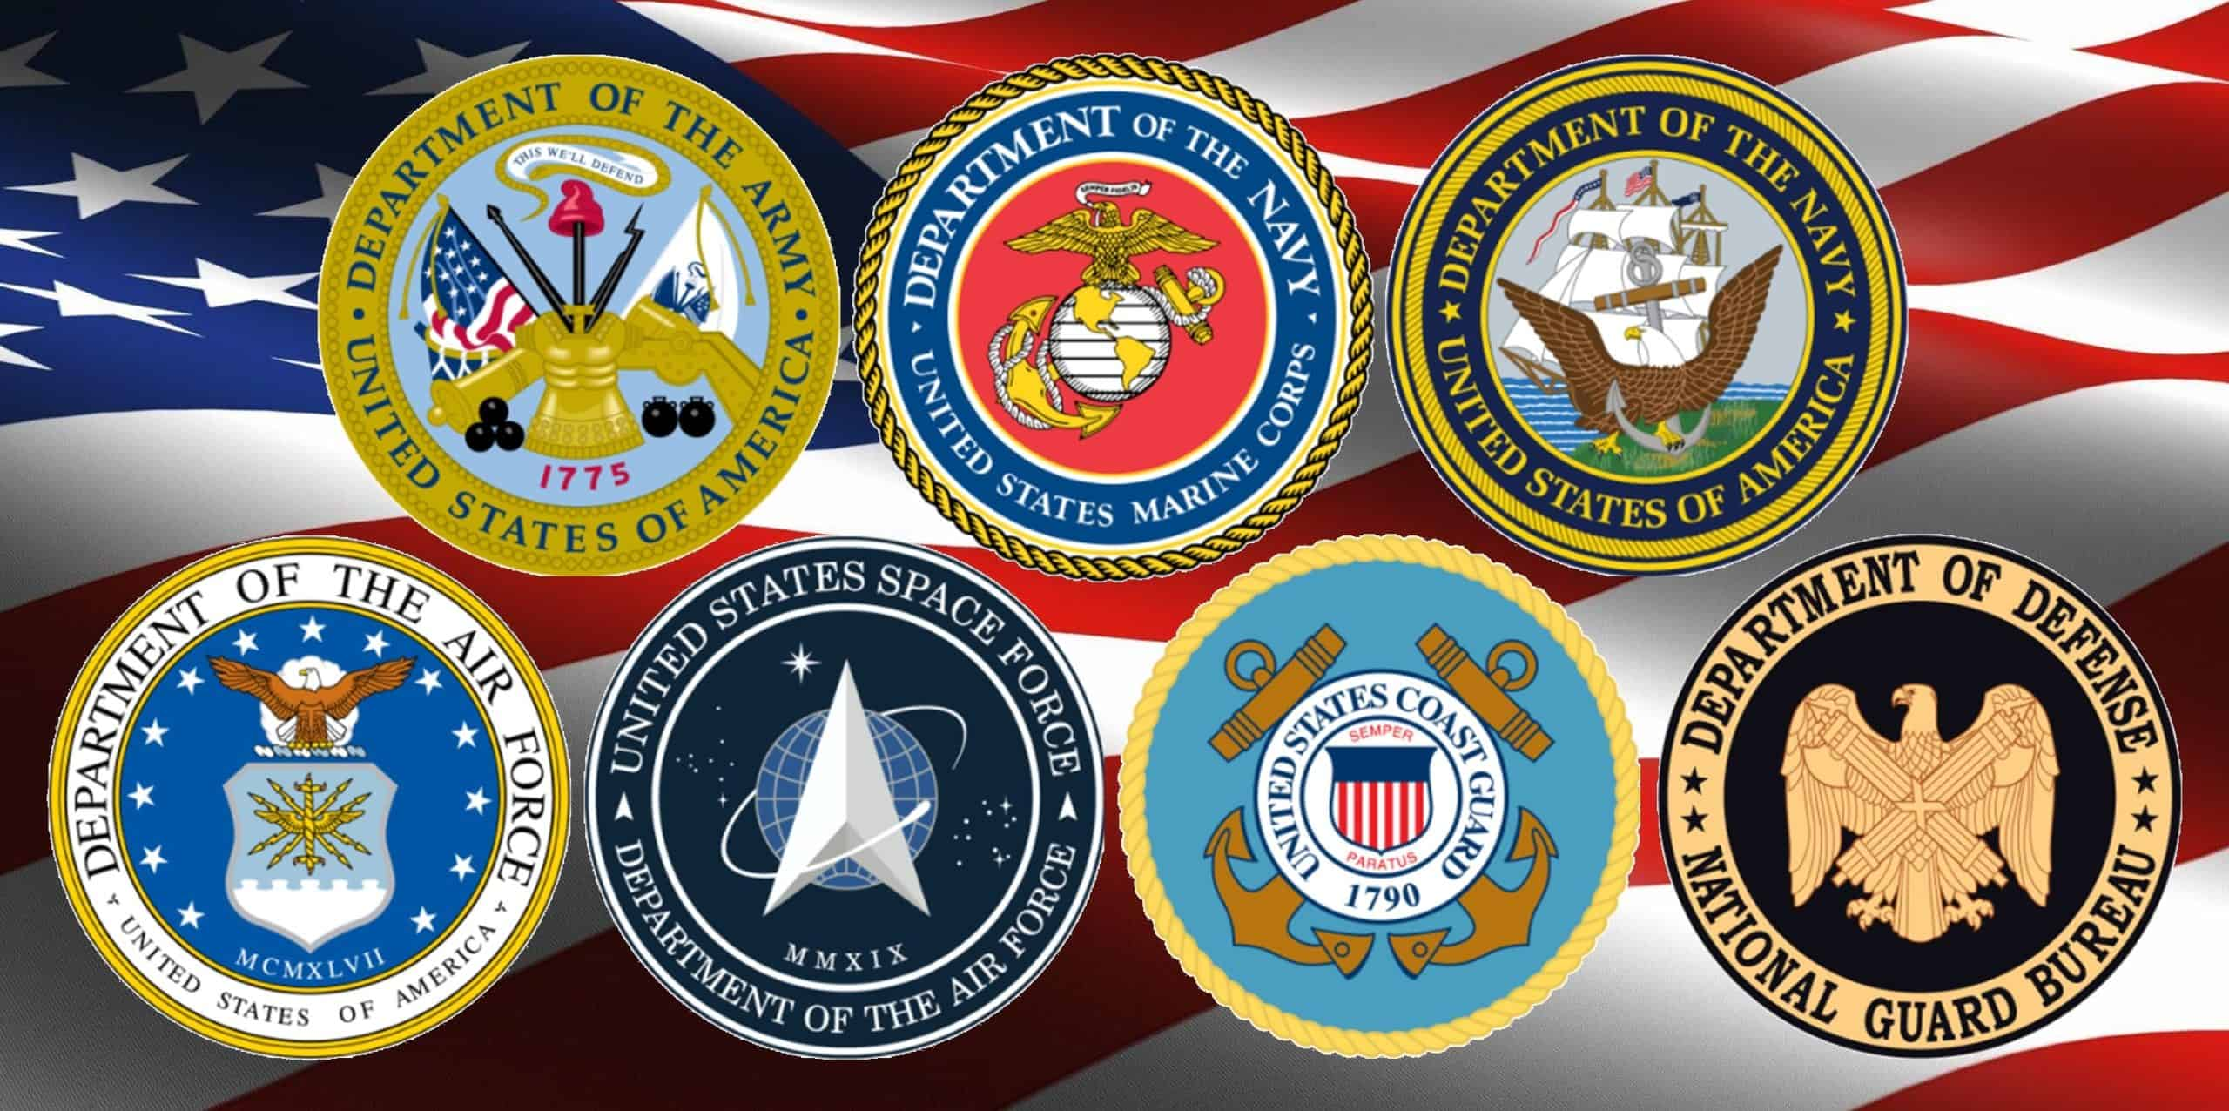
Branches of the Military
Military Branch | Responsibilities | Members | Reserves | Special Forces
Air Force | Execute military operations in the air | Airmen | Air Force Reserve and Air National Guard | Special Warfare
Army | Conduct combat missions on the ground | Soldiers | Army Reserve and National Guard | Green Berets
Coast Guard | Enforce laws at sea, secure waterways, lead search and rescue missions | Coastguardsmen | Coast Guard Reserve | Maritime Security Response Team
Marine Corps | Support other branches in land, sea, and air combat and operations | Marines | Marine Corps Reserve | Marine Corps Special Operations Command
Navy | Protect waterways, provide runways for aircraft when at sea | Sailors | Navy Reserve | Navy SEALS
Space Force | Organize, train, and equip members to conduct global space operations | Guardians | None | None

Slide 13
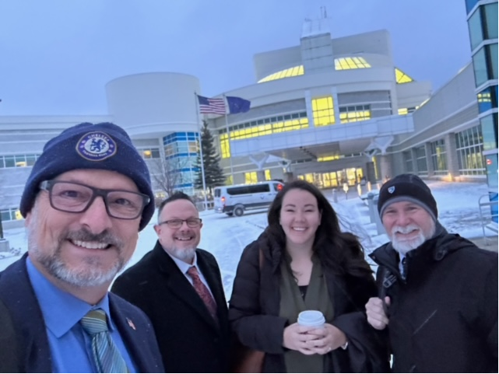
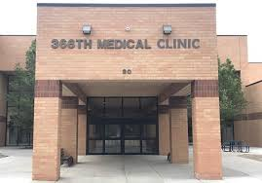
Military Treatment Facility (MTF)
The term “military medical treatment facility” means any fixed facility of the Department of Defense that is outside of a deployed environment and used primarily for health care. There are very large MTF’s with a lot of specialties and smaller MTF’s with very limited specialties.

Slide 14
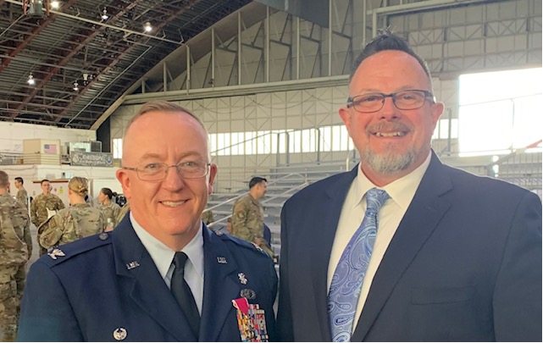
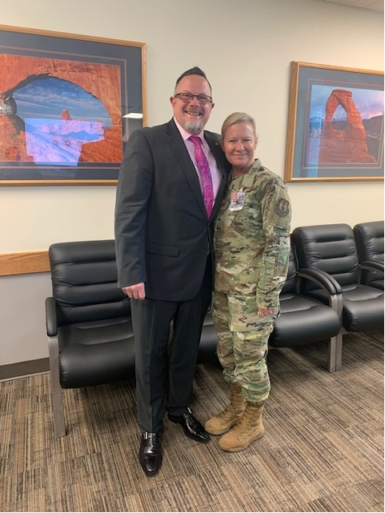
MTF Commander
The commander or director of an MTF established for the purpose of furnishing medical or dental care to eligible individuals. Usually a Colonel or CAPT (USN) in rank.
The commander is like a president or Chief Operating Officer (COO) at a civilian hospital or clinic.

Slide 15
My Role
My main goal everyday is managed care and healthcare optimization at each of the 13 MTF’s I am responsible for are supported each and everyday to include U.S. Army, United States Coast Guard and U.S. Air Force.
Current research suggests that the health care industry has a productivity level of approximately 43%. In a landscape where the demand for care is rapidly increasing, where budgets are continually strained and where regulations are becoming more uncertain and complex, this statistic is neither sustainable nor acceptable. This is where I can assist with optimization or innovative ideas.
Performance Optimization (PO) is a collaborative methodology that addresses modern-day challenges in health care by improving care, accountability, resource management and transparency. It is customized to the needs of individual organizations to create a positive impact on the overall margin of the hospital.

Slide 16
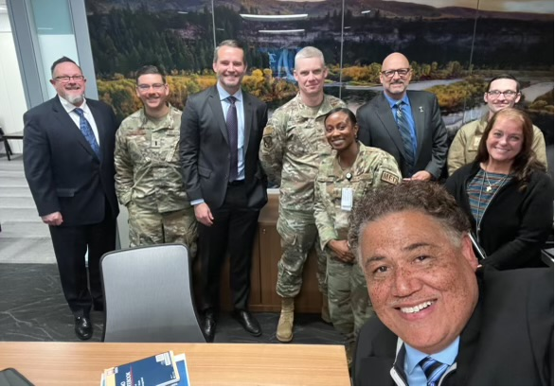
Daily Discussions
As stated, I am either receiving emails or calls from MTF Leadership. They could be for a lot
of different things. Below are some examples of what I discuss with them daily and I will provide a few short example to discuss with you.
Access to Care (ATC)
Behavioral Health
Claims Spend
Deployments
Disasters
Enrollments
ER/UC Utilization
Post/Base Population Increase
Real World Operations

Slide 17
Erin Norman MTF Commander Briefing Exercise
Rules of engagement.
First, this is meant to be fun exercise
I will give an overview of each slide and then ask for your input
Each of you will play the role of a member of the MTF Leadership Team
I encourage participation (all input is welcome)

Slide 18
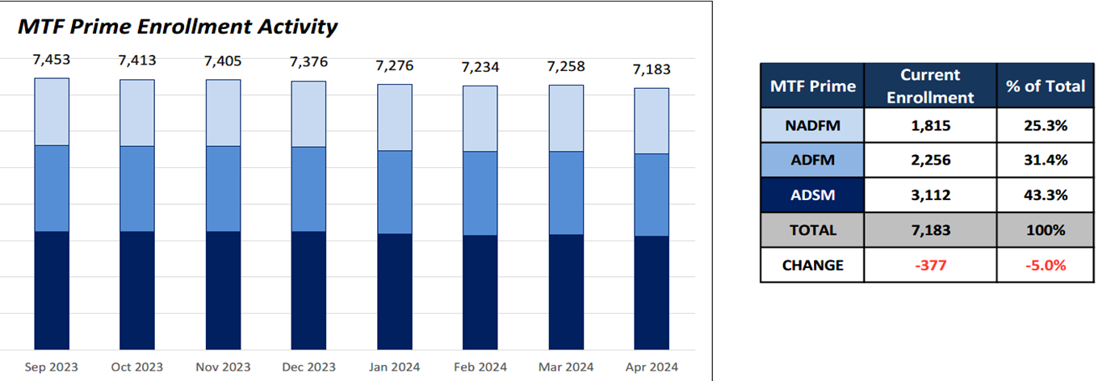
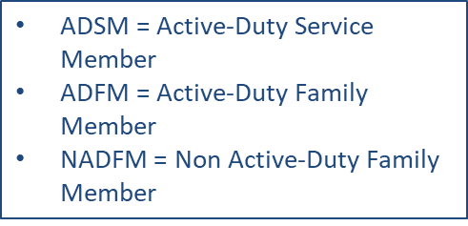
Enrollments Erin Norman MTF
TRICARE Prime is a managed care option available in Prime Service Areas (PSA’s). They ensure medical readiness of active duty by adding to the capability and capacity of military hospitals and clinics.
There are priorities for care in an MTF (ADSM, ADFM, etc).
Prime Service Area (PSA) = Think of a 40-mile circle around MTF.

Slide 19
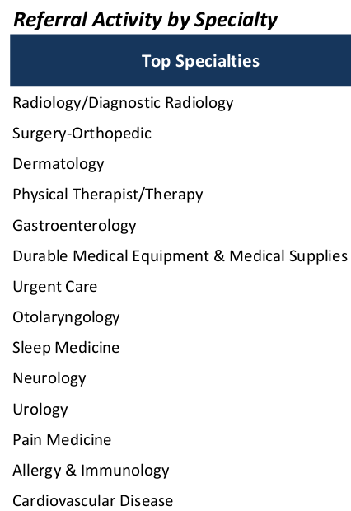
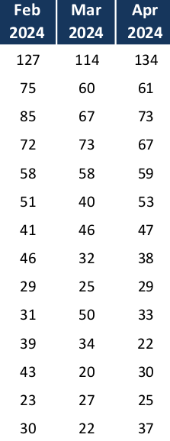
Referral and Authorizations Erin Norman MTF
A referral is when your Primary Care Manager (PCM) or provider sends you to another provider for care that they don't provide. A pre-authorization is when your care is approved by your regional contractor before you go to your appointment.

Slide 20
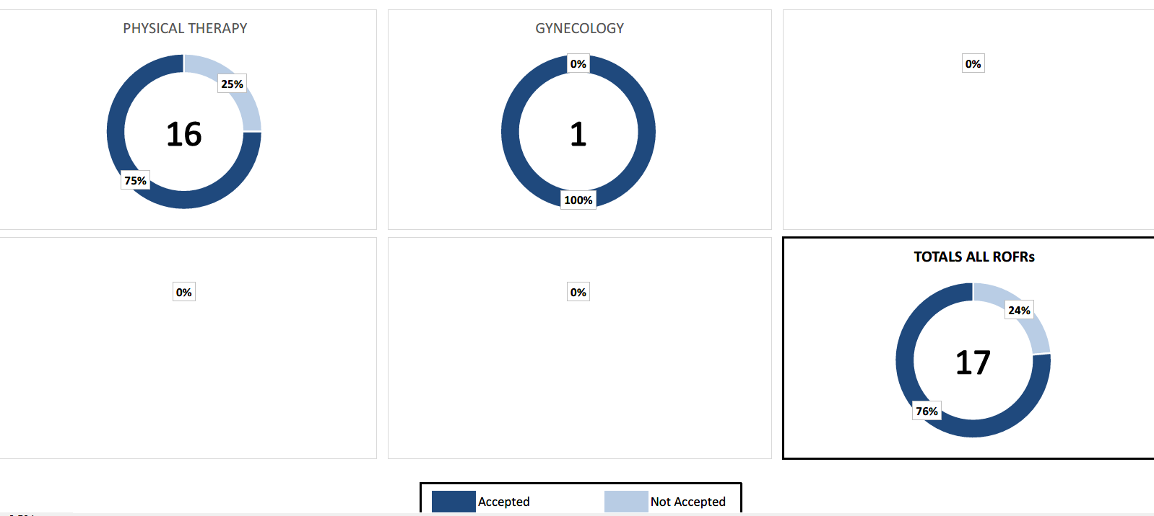
Right of First Refusal (ROFR)Erin Norman MTF
ROFR is when your regional contractor refers you to a military hospital or clinic first. The military facility has the right to take the referral or refuse it. If they refuse it, then you'll get a referral to a network provider.

Slide 21
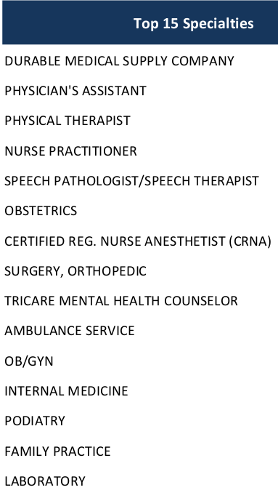
Claims Trend by Specialty Erin Norman MTF
Values are in $1,000 increments
This document is protected as privileged and business sensitive pursuant to FOIA Exemption 4 as a result of commercial and financial information contained herein.

Slide 22
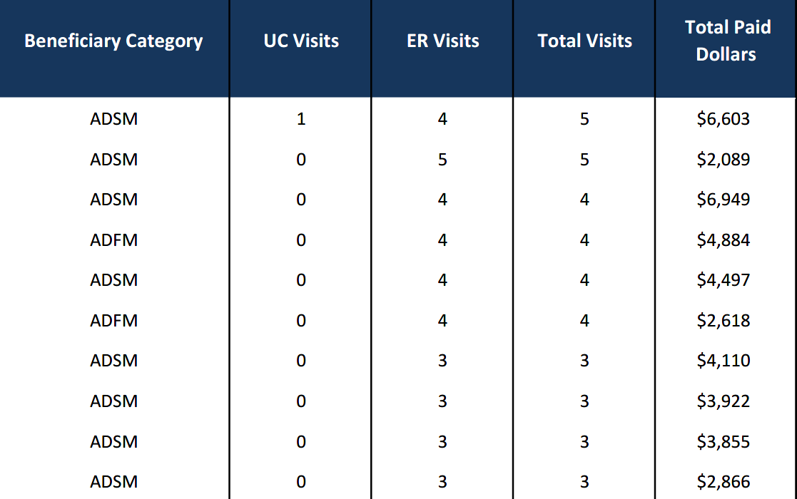
ER/UC High Utilizers Erin Norman MTF
ADSM = Active-Duty Service Member
ADFM = Active-Duty Family Member

Slide 23
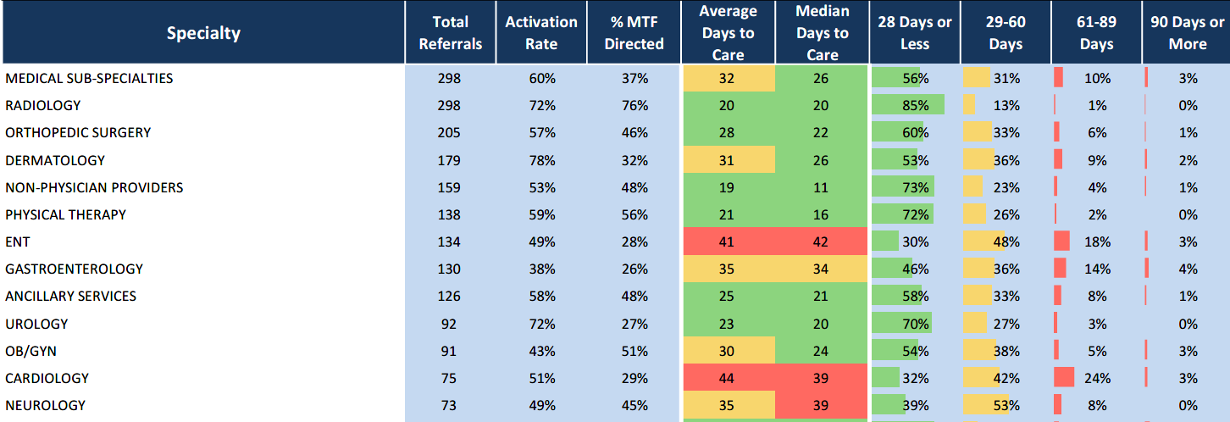
Snapshot-Access to Care Erin Norman MTF
Days to Care on individual cases can increase averages due to beneficiary choice or appointment time.

Slide 24
Beneficiary Category Access to Care Norman MTF
ADSM = Active-Duty Service Member
ADFM = Active-Duty Family Member
NADFM = Non Active-Duty Family Member

Slide 25
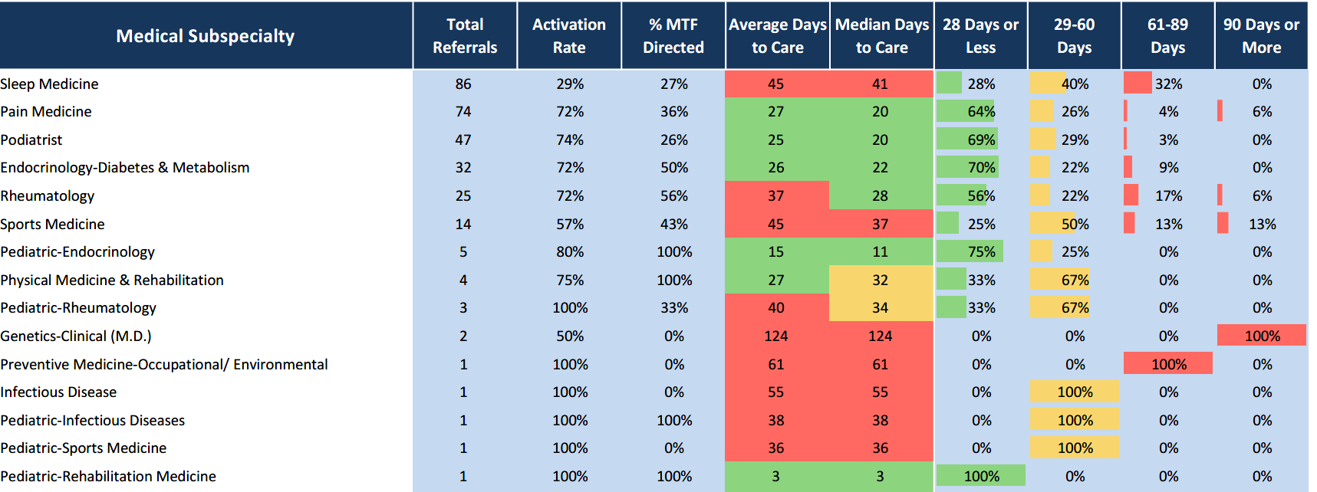
Medical Subspecialty Erin Norman MTF
Days to Care on individual cases can increase averages due to beneficiary choice or appointment time.

Slide 26
Surgical Specialty Erin Norman MTF
Days to Care on individual cases can increase averages due to beneficiary choice or appointment time.

Slide 27
Thank you for your time
Any Questions?

