Slide 1
Coding for Abdominal Hernias with a Revenue Cycle Twist
Feeling incarcerated in hernia repairs?
Melody Draper Hnatovic, RHIT, CHPS, CCS
Revenue Cycle Integrity Analyst
June 1, 2024

Slide 2
Melody Draper Hnatovic, RHIT, CHPS, CCS
Melody is a Revenue Cycle Integrity Analyst for Jefferson Healthcare in Port Townsend, WA. She has over 40 years in HIM and coding experience and is an AHIMA approved ICD 10 CM/PCS trainer

Slide 3
Agenda
Identify the different types of abdominal hernias
Review documentation requirements and apply the appropriate 2023 CPT codes for abdominal hernia repairs
Identify global days and reimbursement
Medical necessity and denials
Importance of the complete revenue cycle
Case examples
References

Slide 4
CPT® Disclaimer
“CPT®” is a registered trademark of the American Medical Association. Their codes, descriptions and manual content are copyright by the AMA. All rights are reserved by the AMA.
This information has been abbreviated for a focused presentation for a specific audience. Verify all codes and information in a current CPT® book.
This information is considered current at the time of this presentation but may change throughout the year. Please check for current guidance on the CMS and Noridian websites.
This presentation does not provide legal or billing advice.
Information is derived from personal experiences with coding, edits and denials.

Slide 5
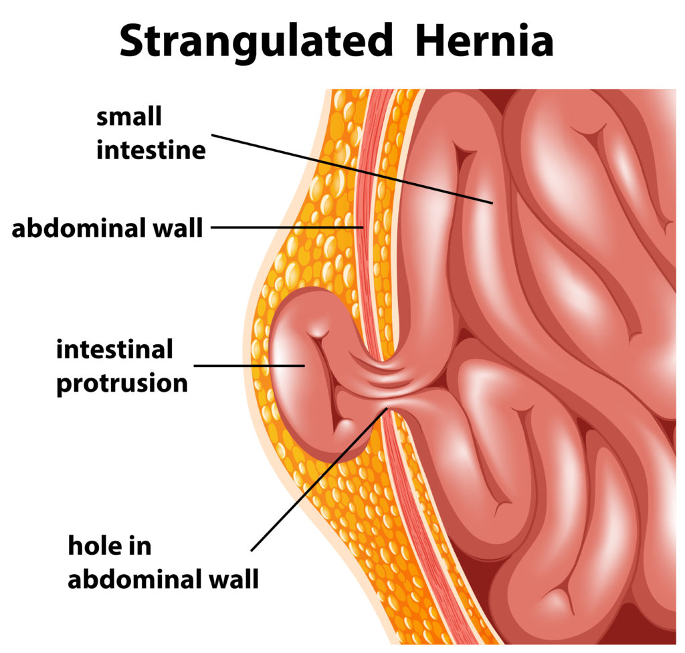
Hernia Terminology
Hernia definition-An organ or fatty tissue squeezes through a weak spot in a surrounding muscle or connective tissue, i.e. fascia. Hernias can contain omentum, fat, or bowel.
Types of abdominal hernias:
Ventral, incisional, epigastric, umbilical, hypogastric, midline, spigelian, subxiphoid.
Reducible- The contents of the hernia can be pushed back through the abdominal wall.
Irreducible- The contents of the hernia cannot be pushed back through the abdominal wall.
Incarceration-A hernia should be considered incarcerated if, at the time of the operation, it contains viscera that the surgeon must manually reduce.
Strangulation/Obstruction-It should be considered strangulated if the incarcerated contents have evidence of ischemia due to compression of the vascular supply.
With gangrene-strangulated hernia with blood supply cut off leading to
Infection and tissue death
Initial- The first time a hernia has formed
Recurrent- A hernia that reappears at or near the site of a previous hernia
abdominal hernia repair 2023 - Search Images (bing.com)

Slide 6
Abdominal Hernia Diagnosis Codes
Umbilical hernias- K42.0- K42.9
Ventral hernias- K43.0- K43.9
Other abdominal hernias- K45.0- K45.8
Unspecified abdominal hernias- K46.0-K46.9
With or without obstruction/strangulation
With or without gangrene
Initial or recurrent
Abdominal Wall Defect Guide: Hernias, Repair Techniques & More | PPT (slideshare.net)

Slide 7
CPT® Codes for Abdominal Hernia Repairs
49591-Repair of anterior abdominal hernia(s) (ie, epigastric, incisional, ventral, umbilical, spigelian), any approach (ie, open, laparoscopic, robotic), initial, including implantation of mesh or other prosthesis when performed, total length of defect(s); less than 3 cm, reducible
49592- less than 3 cm, incarcerated or strangulated
49593- 3 cm to 10 cm, reducible
49594- 3 cm to 10 cm, incarcerated or strangulated
49595- greater than 10 cm, reducible
49596- greater than 10 cm incarcerated or strangulated
49613- Repair of anterior abdominal hernia(s)(ie, epigastric, incisional, ventral, umbilical, spigelian), any approach (ie, open, laparoscopic, robotic), recurrent, including implantation of mesh or other prosthesis when performed total length of defect(s); less than 3 cm, reducible
49614- less than 3 cm, incarcerated or strangulated
49615- 3 cm to 10 cm, reducible
49616- 3 cm to 10 cm, incarcerated or strangulated
49617- greater than 10 cm, reducible
49618- greater than 10 cm, incarcerated or strangulated

Slide 8
Parastomal Hernia
A parastomal hernia is a type of incisional hernia that allows protrusion of abdominal contents through the abdominal wall defect created during ostomy formation
49621- Repair of parastomal hernia, any approach (ie, open, laparoscopic, robotic), initial or recurrent, including implantation of mesh or other prosthesis, when performed, reducible
49622- incarcerated or strangulated
Add on code for mesh removal during abdominal hernia or parastomal hernia repairs
+ 49623- Removal of total or near total non-infected mesh or other prosthesis at the time of initial or recurrent anterior abdominal hernia repair or parastomal hernia repair, any approach (ie, open, laparoscopic, robotic) (List separately in addition to code for primary procedure)
Additional note: infected mesh removal is still coded with add on code +11008

Slide 9
Measuring the hernia defect before you cut
The hernia defect should be measured before opening the fascial defect. Once the tissue is incised, the fascia can retract, causing a defect to appear larger than is accurate.
Measure the total length either transverse or craniocaudal dimensions
Multiple defects are measured as one measurement for all. If defects are separated by greater than or equal to 10 cm, measure each defect and add them together to report 1 code.
Additional note: For abdominal hernias, if one hernia is reducible and one hernia is incarcerated, code all as incarcerated

Slide 10
Clinical Examples
Case 1:
56 y/o male with recurrent 2.5 cm incarcerated ventral hernia, without gangrene- K43.0
Laparoscopic ventral hernia repair- 49614
Case 2:
27 y/o female with 1.5 cm initial ventral hernia incarcerated without gangrene and a 0.8 cm initial umbilical hernia not obstructed with 3 cm distance between- K43.6, K42.9
Laparoscopic ventral and umbilical hernia repairs- 49594

Slide 11
More Clinical Examples
Case 3:
74 y/o male with 2 ventral hernias 1.5 cm and 2.0 cm initial incarcerated with gangrene 2 cm between and a 1.5 cm initial spigelian hernia not obstructed with 10 cm between the ventral and spigelian hernia defects.- K43.7, K43.9
Open repairs 2 ventral hernias and 1 spigelian hernia with mesh- 49594
Case 4:
56 y/o female with 3.0 cm recurrent incisional hernia, incarcerated without gangrene- K43.0
Laparoscopic repair incarcerated ventral hernia with mesh and removal of previous implanted non-infected mesh- 49616, +49623

Slide 12
Multiple Hernias, Different Types
Inguinal, femoral, lumbar, omphalocele, and/or parastomal hernias repaired at the same operative session may be coded separately
Append modifier -59 or –XS (Medicare), as appropriate to the lower weighted procedure code.
Example:
45 y/o male with a 3 cm reducible, initial incisional hernia and a right initial inguinal hernia.
Assign:
59593 (relative weight 62.9798)
49505 -59 or –XS (relative weight 37.7626)

Slide 13
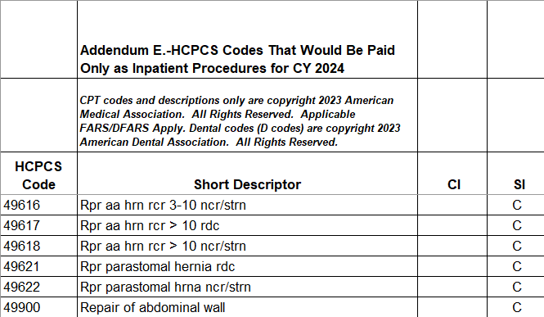
Inpatient only procedures!!!
2024 NFRM OPPS Addendum
License Agreement | CMS

Slide 14
Post-Op Global
The post-op global changed with the new abdominal hernia repair codes. Previously they had a 90 day global. This has been changed to 000 day global which means post-op office visits are no longer included in the global period and may be billed separately.
All other hernia repairs still have 90 day globals

Slide 15
Typical Revenue Cycle Description
Scheduling
Coding & Documentation Review
Denial Management
Payment Posting
Registration
Charge Capture
Claims Processing
A/R Follow-up
Patient Collections
Reporting and Benchmarking

Slide 16
Real Life Revenue Cycle
Surgeon & patient decide on surgery
Eligibility and Preauthorizations
Surgery Scheduler
Case Management
Charge Capture
Coding & Documentation Review
Claims Processing
Denials Management
Claims Processing
Payment Posting
A/R Follow-up
Patient Collections
Registration
Reporting and Benchmarking

Slide 17
Pre-authorizations
Preauthorization is obtained from the patient’s insurance, based on the planned surgery, prior to scheduling surgery. The patient is admitted under the correct status.
Q: What happens when there is an unanticipated outcome leading to the patient being admitted?
A: Case management/Utilization Review must notify the insurance ASAP to notify of admission or the admission is denied.
Q: What happens if the planned outpatient procedure becomes an “inpatient only” procedure and the patient does not get admitted as an inpatient?
A: For Medicare, the surgery is denied!
Q: What happens if the patient starts out with a planned procedure and the actual procedure performed becomes more than or differs from the anticipated surgery?
A: Commercial payors deny!

Slide 18
References
Search the Physician Fee Schedule | CMS
https://www.cms.gov/medicare/physician-fee-schedule/search?Y=0&T=4&HT=0&CT=1&H1=49616&C=9&M=5
Hernia repair updates- CPT® Assistant, September 2023 Page:1
Hernia size determination, clarification- CPT® Assistant, April 2023 Page:26 Category Questions and Answers
Hernia Repair Coding Resources for Surgeons | ACS (facs.org)

Slide 19
Questions?

