Slide 1
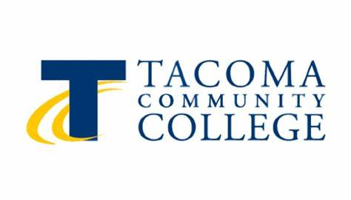
Patient Health Literacy: It’s Everyone’s Responsibility
Darin Challacombe Barb Carr

Slide 2
Objectives
Describe the current conditions of patient health literacy.
Outline the laws, policies, and processes that are meant to help address the issue.
Provide ten easy steps that HIM professionals can take to both meet the regulations and encourage changes from the bottom up.

Slide 3
Health literacy can help us prevent health problems, protect our health, and better manage health problems when they arise.
-U.S. Centers for Disease Control and Prevention, 2023
Notes:
Objective 1. Describe the current conditions of patient health literacy.
This is a statement that has been made and repeated by multiple experts, and this is the thesis for the current presentation.
Health literacy is the single best predictor of an individual’s health status.
To give perspective, the National Adult Literacy Survey reports that a fifth of American adults struggle to read.
Others suggest the number ranges from 13% to 55% of Americans having literacy issues.
Poor health literacy has been reported as associated with various adverse health outcomes: navigation difficulties within the health system, inaccurate or incomplete reports related to medical history, missed doctor appointments, inaccurate use of medications in terms of timing (multiple reports). Health literacy was also found to be associated with functioning in the digital domain, so that low health literacy (and related skills) are negatively related to the ability understand (Zikmund-Fisher, Exe, & Witteman, 2014), evaluate online health information and trust in online health information.

Slide 4
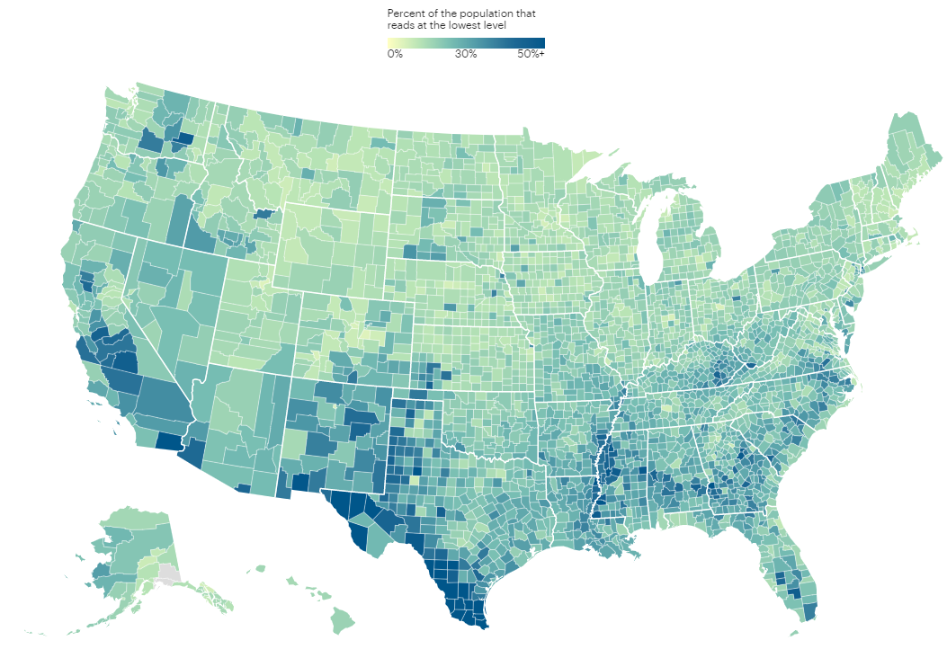
Notes:
Propublica’s (2022) map of Hot Spots of Low Literacy based on data from the National Center for Education Statistics.
https://www.propublica.org/article/literacy-adult-education-united-states
This is basic literacy issues. This does not have any factor into health literacy or the rates related to this area. With the addition of special terminology of the medical field, the map would likely be skewed more.
Evolution of education

Slide 5
Literacy
Illiteracy: Total inability to read or write.
Low literacy: Adults with comprehension between 5th and 8th grade levels.
Functional illiteracy: Ability to read/write below 5th grade level.
An estimated 2 out of every 5 adults 65 years old or older are considered functionally illiterate.
Notes:
Let’s start out with some definitions --
Illiteracy: Total inability to read or write. An estimated 5% of American adults fall within this category Low literacy: Adults with comprehension between 5th and 8th grade levels
Functional illiteracy: Ability to read/write below 5th grade level. Almost 2 out of every 5 adults 65 years old and older read below a 5th grade level.
As the previous map showed, there are pockets of the country with lower literacy rates, including some Southern states (e.g., Louisiana, Texas, Mississippi). Also, Americans who are economically disadvantaged, immigrants (especially undocumented immigrants) and high school dropouts top the list of those with lower literacy.

Slide 6
Screening for Literacy
There are several tools utilized to assess a patient’s reading ability:
WRAT (Wide Range Achievement Test)
TOFHLA (Test of Functional Health Literacy in Adults)
REALM (Rapid Estimate of Adult Learning in Medicine)
Notes:
WRAT: Patient is asked to read 100 words. After three mispronunciations, the test is stopped and scored as the number of words missed/not tried. This test was originally developed in 1936 and is only useful for English speaking patients.
TOFHLA: Developed to assess patients' functional health literacy using actual materials from the hospital setting, such as prescription labels, appointment slips, and informed consent, not just isolated words. The test consists of two parts: reading comprehension and numeracy. Takes up to 22 minutes to administer. There is a Spanish version.
REALM: 66-word reading recognition test that measures a patient's ability to pronounce common medical and lay terms for body parts and illnesses. The terms are arranged in three columns beginning with short, easy words and ending with more difficult words. The advantage of the REALM over the WRAP is that it measures the patient’s ability to read medical/health-related words.
** Even still, a recent study (Voight-Barbarowicz & Brutt, 2020) found healthcare professionals had difficulty determining patients’ health literacy. It was recommended because the healthcare providers

Slide 7
Readability
Several measures to determine readability:
Fog Index
Fry Formula
SMOG
Flesch
Notes:
Fog Index. The Fog Index was developed by Gunning in 1968 to evaluate the readability of materials from the fourth grade to college level. The formula is based on the average sentence length and the percentage of multisyllabic words in a 100-word passage. The index is considered one of the easiest methods because it is based on a short sample of words and does not require counting syllables.
Fry Formula. The Fry formula is widely accepted among reading professionals and is not copyrighted. This formula is applicable to grades 1 through 17. Three 100-word passages are selected and the number of sentences are counted, along with syllables. Data are evaluated by a Fry graph, which converts totals to grade level .
SMOG. G.H. McLaughlin developed the SMOG formula in 1969. It is regarded as one of the simplest and most accurate and valid analyses of readability.5 Its popularity is based on its reading-level accuracy, simple directions, and speed of use. The SMOG formula is based on 100% comprehension of material read and has been used extensively to judge the grade-level readability of patient education materials. The SMOG measures readability based on the number of polysyllabic words in a set number of sentences. The square root of the total number of polysyllabic words, estimated to the nearest perfect square, is added to 3 and then converted using a table to define the grade level needed for comprehension.
Flesch Formula. The Flesch formula was developed as an objective measurement of the readability of materials between grade five and college level. This formula is based on a count of two basic language elements: average sentence length and average word length. The reading ease score is calculated by combining the variables. The Flesch formula's validity has been well established.
***The Flesch is the most commonly known type.

Slide 8
Study 1
Data: Top 150 US-based hospitals per Newsweek 38 states (top being CA with 20, OH with 11, and TX with 9 hospitals)
Method: Obtained the personal or third-party ROI form from website. Used Microsoft Word’s to evaluate reading ease using Flesch method. Also evaluated readability grade level using the Flesch-Kincaid method.
Notes:
Newsweek rank ordered the top hospitals in the world for 2023. We then examined the list for just the United States, and evaluated
The Flesch Reading Ease score ranges from 0 to 100. Aim for a 60+ score minimum. Note that visitors typically scan web pages versus reading content. The higher the page score, the easier it is for viewers to scan.
The Flesch-Kincaid Grade Level is equivalent to the US grade level of education. It shows the required education to be able to understand a text. Text intended for readership by the general public should aim for a grade level of around 8, schooling age 13 to 14

Slide 9
Study 1
Results.
Only one facility had an authorization with a readability above 60 (61.4).
That same facility was the only one with a Flesch-Kincaid grade level of below 8 (7.3).
 | Mean | Mode | Standard Deviation
Flesch Reading Ease | 37.4 | 21.2 | 8.5
Flesch-Kincaid Grade | 12.2 | 12.4 | 2.0
Pages | 1.8 | 2 | 0.9

Slide 10
Study 1
Discussion.
Except for one facility, all 150 top hospitals in the US have ROI authorizations that are likely too difficult for many patients to read or understand.

Slide 11
Study 2
Data: Top 150 US-based hospitals per Newsweek 38 states (top being CA with 20, OH with 11, and TX with 9 hospitals)
Method: Obtained three patient-facing documents from health system websites:
Consent to Treat
Notice of Privacy Practices
PHI Access Form
Notes:
Newsweek rank ordered the top hospitals in the world for 2023. We then examined the list for just the United States, and evaluated
The Flesch Reading Ease score ranges from 0 to 100. Aim for a 60+ score minimum. Note that visitors typically scan web pages versus reading content. The higher the page score, the easier it is for viewers to scan.
The Flesch-Kincaid Grade Level is equivalent to the US grade level of education. It shows the required education to be able to understand a text. Text intended for readership by the general public should aim for a grade level of around 8, schooling age 13 to 14

Slide 12
Study 2
Results.
Consent to Treat | Mean | Mode | Standard Deviation
Flesch Reading Ease | 37.6 | 32.8 | 10.9
Flesch-Kincaid Grade | 13.3 | 14.3 | 2.6
NPP | Mean | Mode | Standard Deviation
Flesch Reading Ease | 41.6 | 31.4 | 8.8
Flesch-Kincaid Grade | 12.1 | 14.5 | 1.5
PHI Access | Mean | Mode | Standard Deviation
Flesch Reading Ease | 36.3 | 19.9 | 9.2
Flesch-Kincaid Grade | 12.5 | 11.5 | 2.0

Slide 13
Overall Discussion
Many patients likely do not know what they are signing, hence why often forms are not completely filled out.
Patients do not understand their rights and the responsibilities of their health care professionals.

Slide 14
Laws, Policies, and Processes
Objective 2. Outline the laws, policies, and processes that are meant to help address the issue.
One of the main laws relating to patient health literacy is the 2010 Plain Writing Act which requires that federal agencies use clear government communication that the public can understand and use.

Slide 15
Laws, Policies, and Processes
HHS
45 CFR 164.508(b)(4) 45 CFR § 164.508 - Uses and disclosures for which an authorization is required. | Electronic Code of Federal Regulations (e-CFR) | US Law | LII / Legal Information Institute (cornell.edu)
Privacy Rule. “All authorizations must be in plain language and contain specific information regarding the information to be disclosed or used, the person(s) disclosing and receiving the information, expiration, right to revoke in writing, and other data.”

Slide 16
10 Easy Steps to Improve
Notes:
This is a statement that has been made and repeated by multiple experts, and this is the thesis for the current presentation.
Health literacy is the single best predictor of an individual’s health status.
To give perspective, the National Adult Literacy Survey reports that a fifth of American adults struggle to read.
Others suggest the number ranges from 13% to 55% of Americans having literacy issues.

Slide 17
1. Refocus priority on the patient
Many organizations have shifted the focus on legal or compliance issues
The patient is the reason that we are here
HIM is often the last impression patients have of a health care facility
We want patients to have their PHI, they have better outcomes when informed
HI professionals do have the knowledge to interpret what a patient is asking for and can ease many processes
Know what is needed for transfer to specialty or tertiary care facilities when patients are overwhelmed

Slide 18
2. Regularly review common, patient-facing forms
Forming or utilizing a multi-disciplinary team to regularly review any patient-facing forms
Don't limit your work to ROI forms (e.g. authorizations, amendments, restrictions)
Making this an enterprise-wide initiative can help with patient engagement
Schedule out form revisions so you can portion out work

Slide 19
3. Ensure facility has a plain language policy
Regularly updated policies remind you to periodically review
Plain language isn't just found in HIPAA, there's additional statutes
Federal government has guidelines from the 2010 Plain Language Act
https://www.plainlanguage.gov/guidelines/
Make sure that other departments and sub-business units are aware of the policy
Generally speaking there's an effort to centralize forms but we all know that different departments go "rogue"

Slide 20
4. If translated, ensure forms are similarly easy to understand
Know the language demographics of your service area
It may be worthwhile to translate some forms into additional languages if you anticipate further growth
Prepared with forms for when that population reaches size
Use a certified translator (not Google translate)
Most health care facilities will have certified professionals available
Just as not anyone can translate in court, it's the same with medical forms

Slide 21
5. Train staff to be able to explain forms and concepts
It's all about the patient experience
Not only is it the right thing to do but it can prevent patient access complaints
Staff should be allowed to take the time necessary to assist patients and not rush patients
Have an area where staff can work with patients with greater or specialty needs
Vision impaired patients may not be able to easily read forms
Elderly patients may have tremors that make completing forms difficult
Neurodivergent patients may become overwhelmed and have additional questions.

Slide 22
6. Ensure all patient-facing forms go through readability tests
Check with your Training department to see what resources are available
Some organizations will require an approval from other departments:
Forms Committee
Legal/Risk Management
Compliance
Do a trial run with Microsoft's available solutions or other free tools

Slide 23
7. Consider the font used, spacing, size
Consider your patient population demographics
Growing elderly population means a possible need for a larger front
Increased awareness of the neurodivergent community has led to the development of a neurodivergent-friendly font
Small font or "serif" fonts may result in difficulty reading accent marks or other language-specific characters.
"Cluttered" authorizations may deter patients from completing the form, reading it in its entirety, or selecting "all" just because it's first.

Slide 24
8. It’s OK to have the form be more than one page
The elephant in the room …
Yes, patients can forget to …
Print/return all pages
Complete all pages
It costs more to provide copies
However, more room increases readability and encourages patients to detail their actual request
Fewer delays in processing due to lack of clarity
Reduces risk of patient access complaints

Slide 25
9. Use features of your website/PDF creator to explain the form
Information bubbles
The nifty little pop-ups that you see when you hover over a term
Have clear visual cues to indicate which terms have an active link
Separate glossary and instructions for each form
If patient is using paper, they can place side-by-side for reference
Paper handout can be used to assist PC users

Slide 26
10. You don’t have to reinvent the wheel
Reach out to neighboring facilities
Share common demographics so similar language needs, patient profiles
Other organizations may have recently reviewed their forms
Find resources on AHIMA Access and Body of Knowledge

Slide 27
Questions & Next Steps
Notes:
Liz

Slide 28
References
Badarudeen, S., & Sabharwal, S. (2010). Assessing readability of patient education materials: Current role in orthopaedics. Clinical Orthopaedics and Related Research, 468(10). doi:10.1007/s11999-010-1380-y
Kaphingst, K. A., Weaver, N. L., Wray, R. J., Brown, M. L. R., Buskirk, T., & Kreuter, M. W. (2014). Effects of patient health literacy, patient engagement and a system-level health literacy attribute on patient-reported outcomes: A representative statewide survey. BMC Health Services Research, 14.
Neter, E., & Brainin, E. (2019). Association between health literacy, eHealth literacy, and health outcomes among patients with long-term conditions: A systematic review. European Psychology, 24(1). doi:10.1027/1016-9040/a000350
Quirk, P. A. (2000). Screening for literacy and readability: Implications for the advance practice nurse. Clinical Nurse Specialist, 14(1).
Shahid, R., Shoker, M., Chu, L. M., Frehlick, R., Ward, H., & Pahwa, P. (2022). Impact of low health literacy on patients’ health outcomes: A multicenter cohort study. BMC Health Services Research, 22. doi:10.1186/s12913-022-08527-9
Voigt-Barbarowicz, M., & Brutt, A. L. (2020). The agreement between patients’ and healthcare professionals’ assessment of patients’ health literacy—A systematic review. International Journal of Environmental Research and Public Health, 17. doi:10.3390/ijerph17072372
Wang, M. J., Lo, Y. T. (2021). Improving patient health literacy in hospitals—A challenge for hospital health education programs. Risk Management and Healthcare Policy, 14.

Slide 29
Thank you!
Barb Carr
BCarr@verisma.com
Darin Challacombe
DChallacombe@verisma.com
Notes:
Liz

